Slide 1
Efficient Sparse Voxel Octrees
Samuli Laine Tero Karras
NVIDIA Research

Slide 2
“Bitmaps” vs “Vectors”
Bitmap 2D image
Vector 2D image

Slide 3
Why Not “Bitmaps” in 3D?
?
“Bitmap” 3D object
Vector 3D object

Slide 4
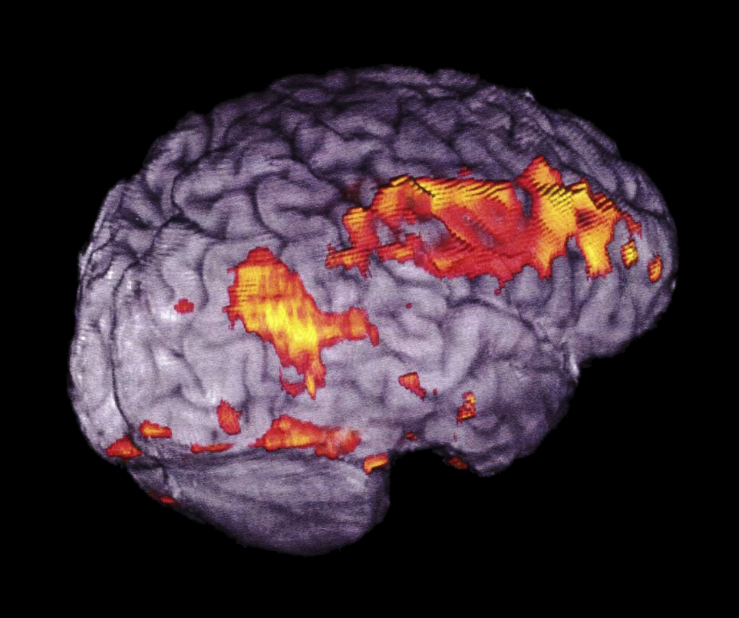
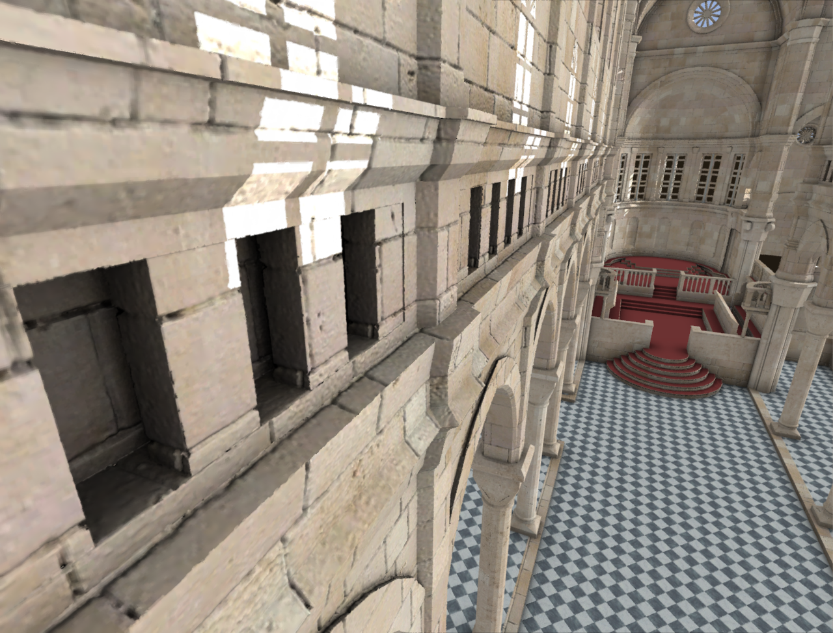
Voxels != Volumetric
Voxel datasets often consist of volume data → O(n³) memory consumption. Ouch!
But usually we only see the surfaces of things
Surfaces have O(n²) memory consumption, i.e. relative to surface area. Much better.
Needs a smart data structure

Slide 5
Properties of Sparse Voxel Octrees
+ Unique geometry and texture everywhere
Enables new kind of authoring and capture
+ Fine-grained resolution control
+ Compact representation
Position information is implicit
No surface parameterization needed
+ Easy to downsample
– Deformations are very difficult
– Data sets are large
– Lack of authoring / editing tools

Slide 6
Summary of Contributions
Compact data structure that supports efficient ray casts
Contours for more accurate surface representation
Normal compression for object-space normals
Efficient ray traversal algorithm
Beam optimization for reducing workload
Post-process filtering for removing blockiness

Slide 7
Octree Data Structure
Memory consumption O(m), where m is the number of leaf nodes
One child pointer per voxel
Siblings stored in consecutive addresses

Slide 8
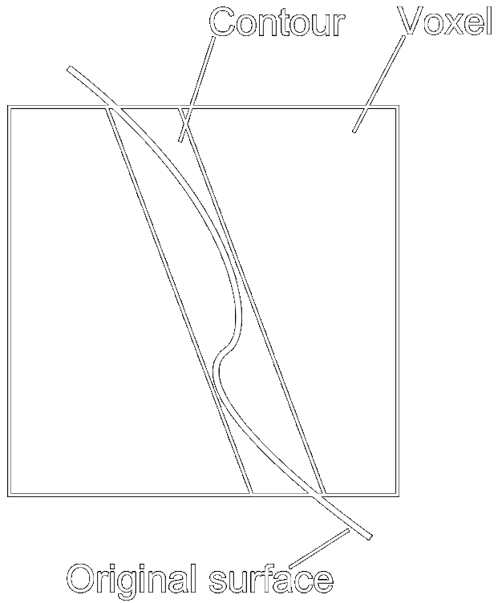
Contours
Contours are slabs that modify voxel’s shape
Improve accuracy for representing surfaces
Versatile — collaboration between multiple levels for sharp edges and corners
Simple for rendering

Slide 9
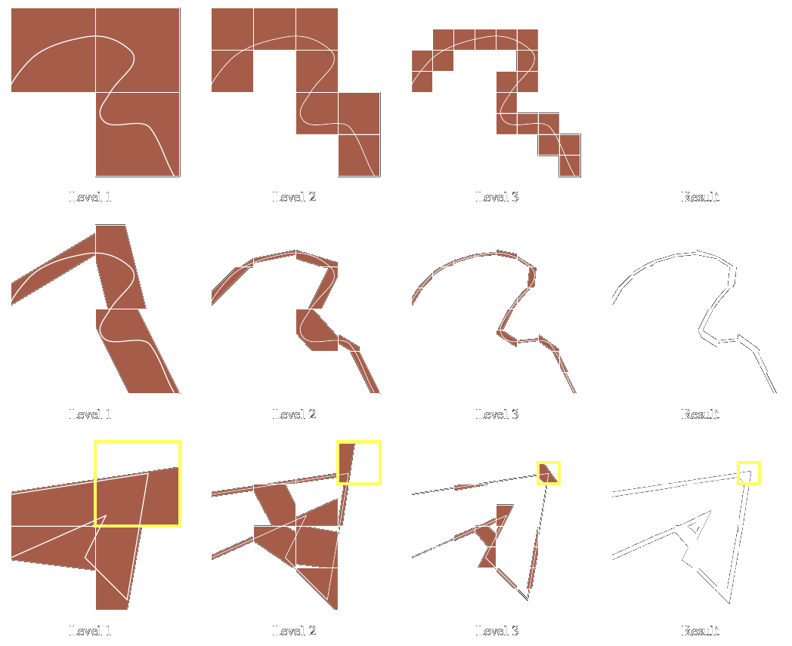
Cubes vs Contours
Cubical
voxels
Contours
Collaborating contours

Slide 10
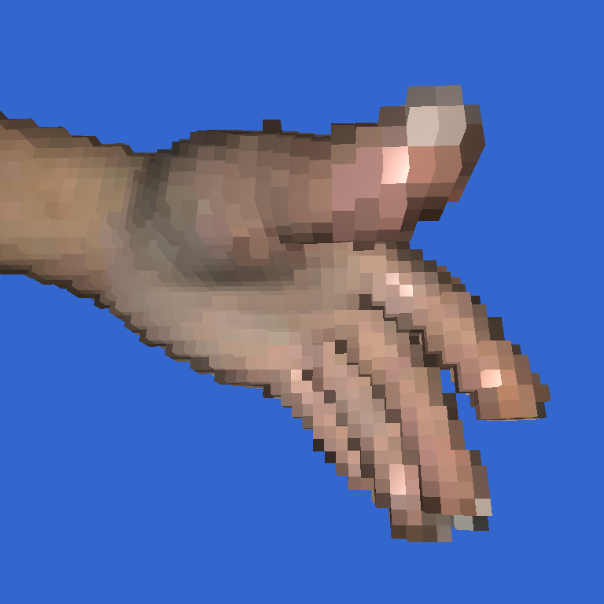
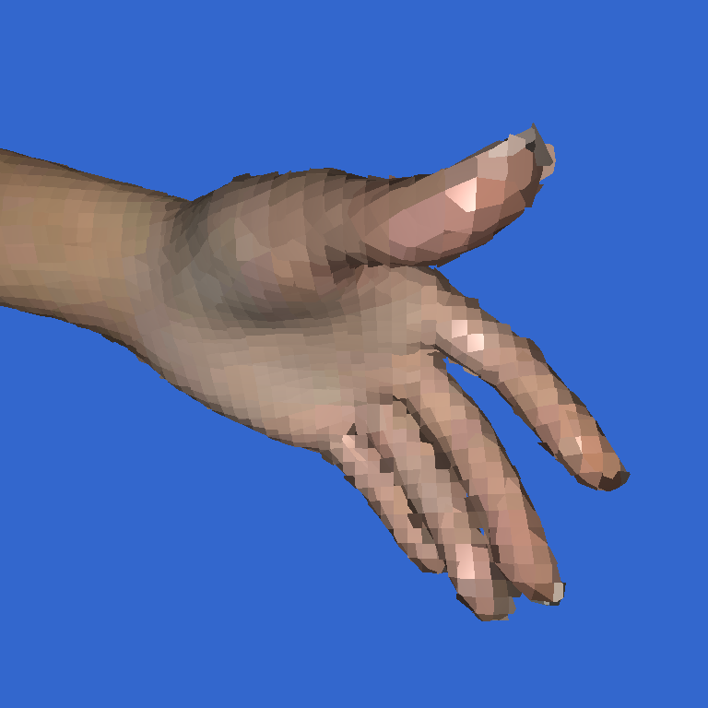
Contours in Action
No contours
With contours
Note: low-resolution voxelization!

Slide 11
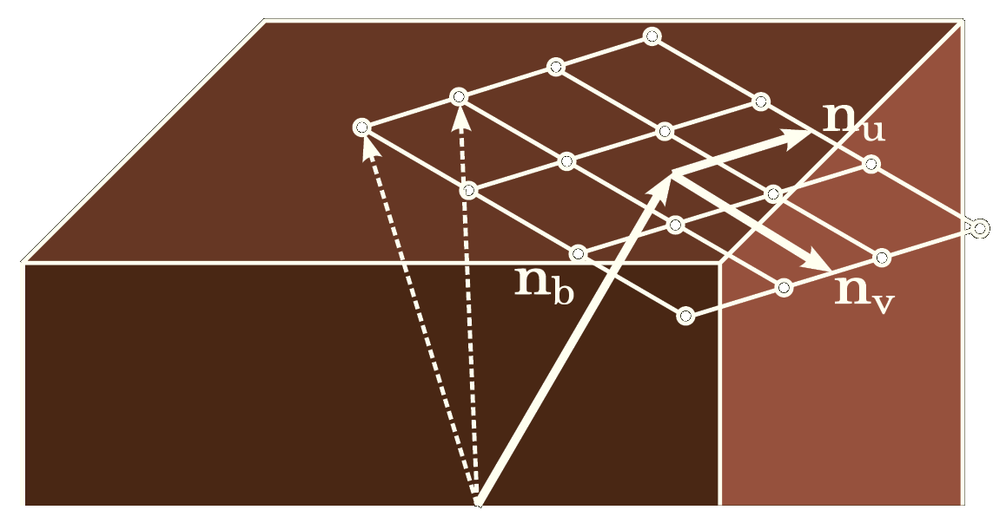
Compression
Pointers as 15-bit offsets
Separate far pointers when necessary
Colors compressed using DXT1 encoding
Novel DXT-like block-based high-precision object-space normal compression format

Slide 12
Voxel Memory Usage
Hierarchy 1 byte
Color 1 byte (DXT1 compression)
Normal 2 bytes (novel compression format)
Contour 1+ bytes (adaptive use)
Total 5+ bytes / voxel
4 GB memory ≈ 640 m² (6900 sq.ft) with 1 mm² resolution
! Resolution requirements drop with distance

Slide 13
Octree Ray Casting Algorithm
Walk octree nodes along the ray
Simple and efficient due to regular structure
Three basic cases
Push: go to child voxel
Advance: go to sibling
Pop: jump to higher level
Many algorithmic tricks

Slide 14
Ray Traversal
Stack
1000
0111
0110
0101
0100
.
.
0011
.
0010
0001
0000
0000
0001
0010
0011
0100
0101
0110
0111
1000

Slide 15
Beam Optimization
Reduce ray cast workload by starting rays closer to geometry
1st pass: Generate low-resolution depth image
Geometry cannot be missed if we stay on coarse enough octree levels!
Determine starting distance for each beam defined by four coarse rays
2nd pass: Cast individual rays

Slide 16
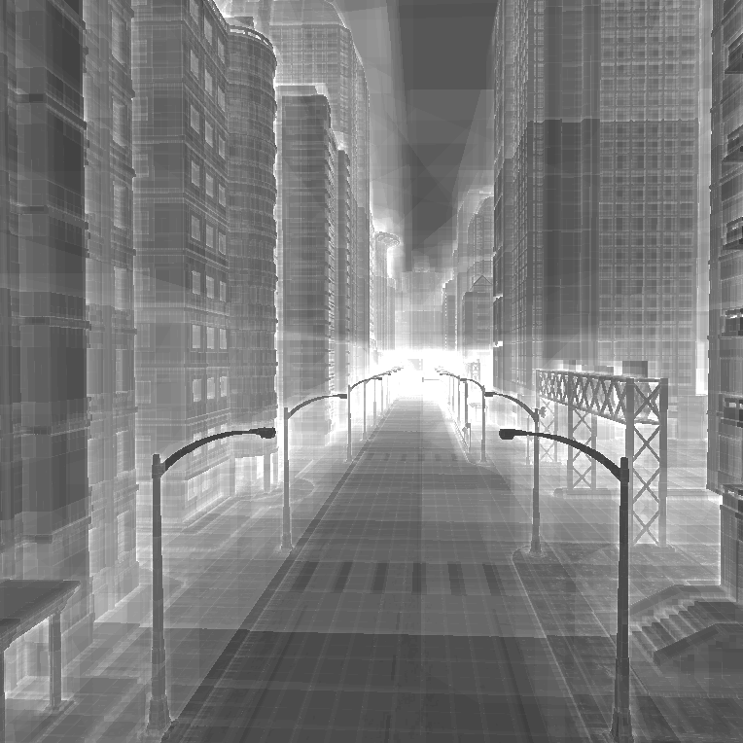
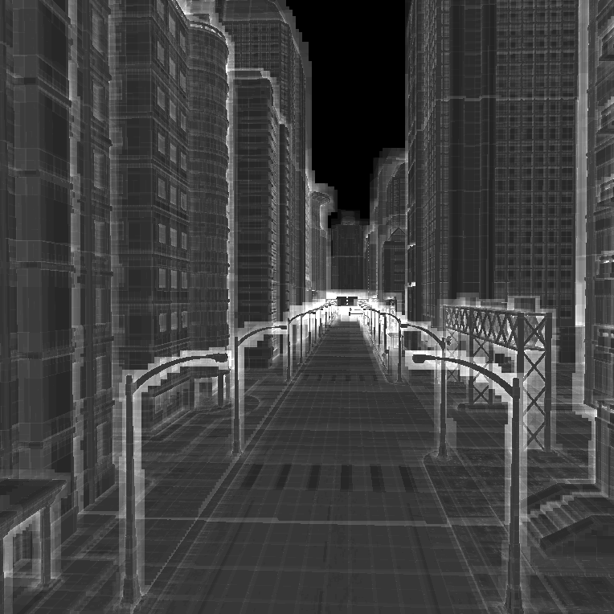
Beam Optimization, cont’d
No beam optimization
With beam optimization
Iteration counts: black=0, white=64

Slide 17
Post-Process Filtering
Thanks to contours, the shape is mostly accurate
Shading still gets blocky when out of resolution
Solution: post-process filtering
Adapts to content, single pass, no seams

Slide 18
Filtering Example
No filtering
With filtering
Note: low-resolution voxelization!

Slide 19
Video

Slide 20
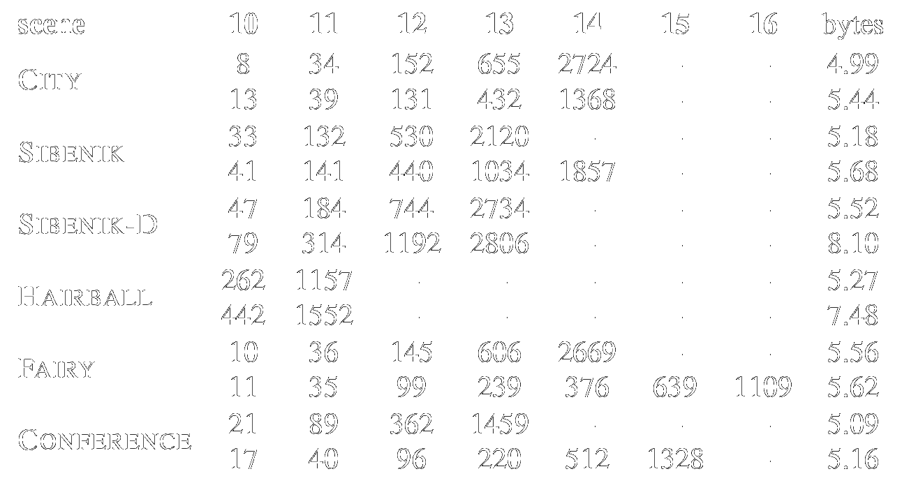
Memory Usage
Numbers in MB
no contours
with contours
bytes/voxel including all overheads

Slide 21
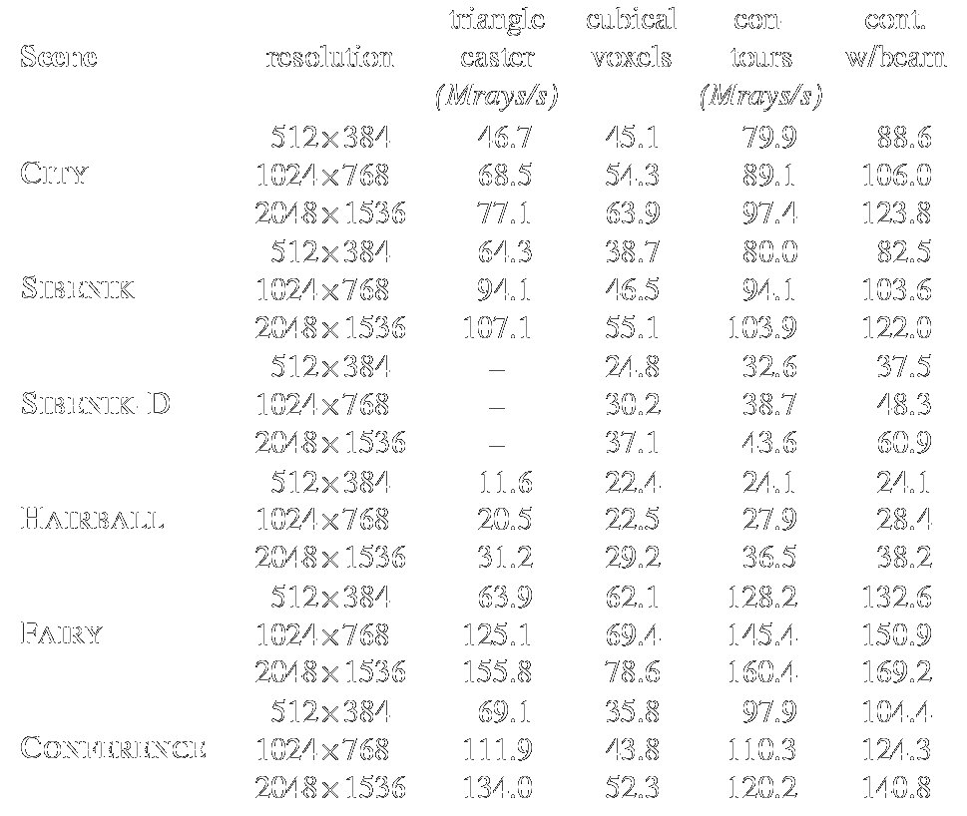
Ray Cast Performance
Mrays /
second
<

Slide 22
Future Challenges
Coexistence of voxel and vector formats for 3D?
As in 2D today
How to author voxels in large scale?
Where to fit all the data?
Capturing real-world content?

Slide 23
Resources
Technical report
More analysis, details, results, etc.
Open-source codebase http://code.google.com/p/efficient-sparse-voxel-octrees/
Hierarchy construction
Optimized CUDA kernels for ray casting
Benchmarking framework, etc.
An application, not bits and pieces

Slide 24
Thank You

Slide 25
Backup Slides

Slide 26
Storage Considerations
How to store data on disk?
We want to adjust resolution locally
Always use all data that is read
Data stored on disk as slices
How to store data in memory?
Rendering efficiency
Compact storage
Data stored in memory as blocks

Slide 27
Slices vs Blocks
Octree on disk
Octree in memory

Slide 28
Sibenik-D
13 levels, 2806 MB

Slide 29
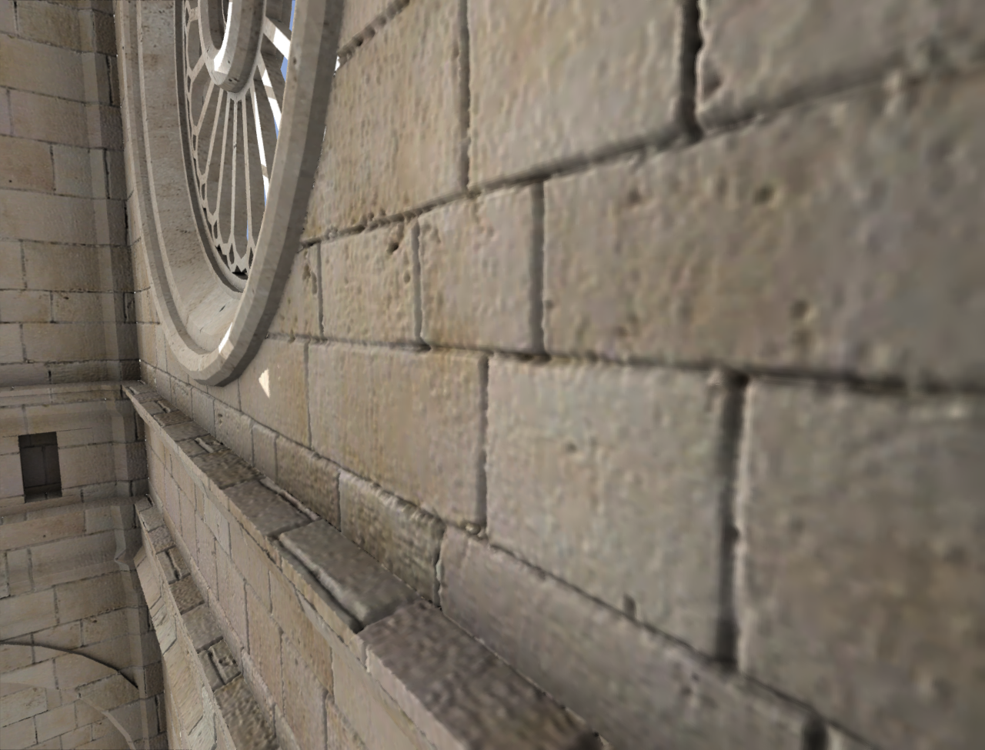
Examples: Sibenik-D

Slide 30
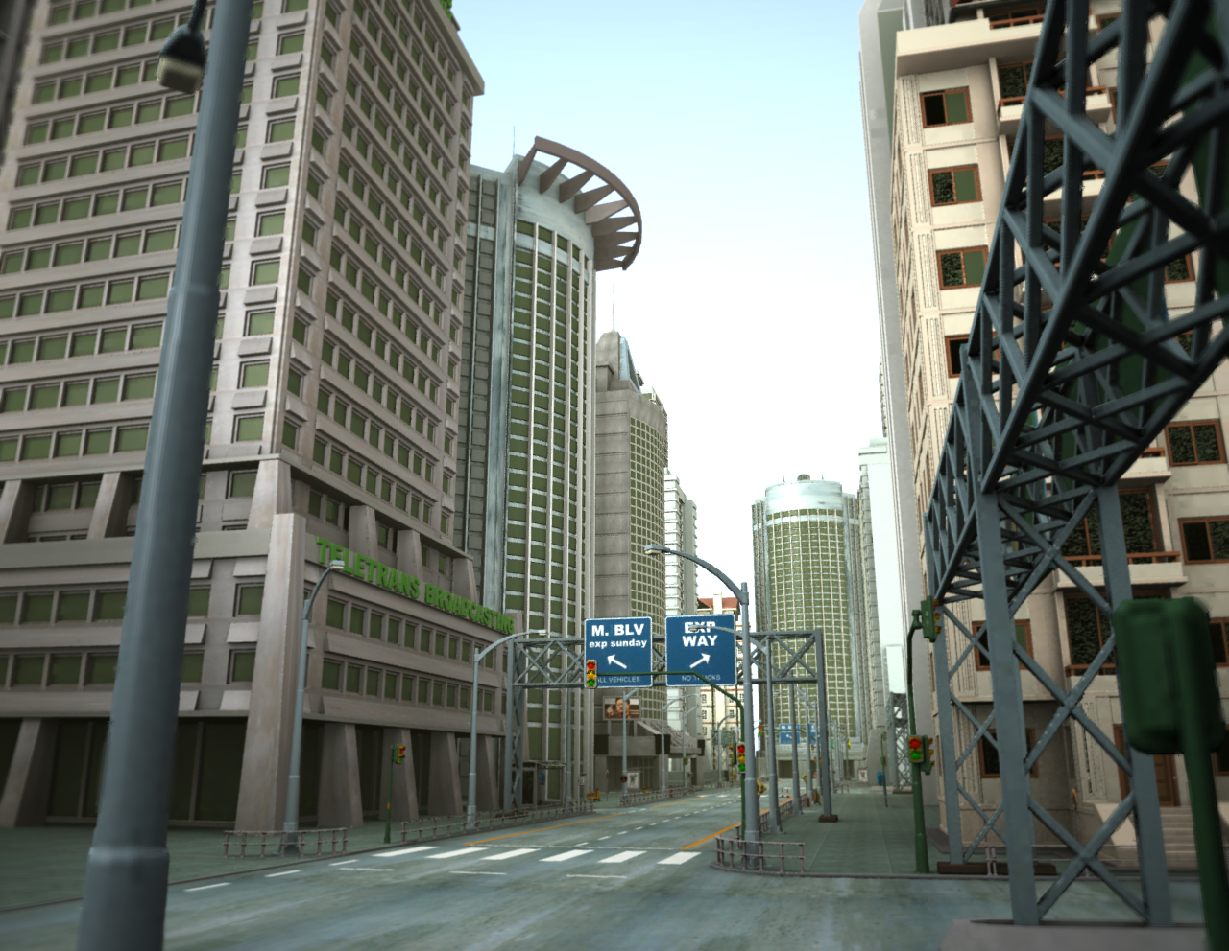
Examples: City
14 levels, 1386 MB

Slide 31
Examples: Hairball
11 levels, 1552 MB

