Slide 1
FASTANN FOR HIGH QUALITY COLLABORATIVE FILTERING
Yun-Ta Tsai, Markus Steinberger, Dawid Pająk, Kari Pulli
Notes:
Hi Everyone. Thank you for attending my talk. Here I am going to present an efficient way to solve one of the biggest problems in image processing. And it potentially has big impact in your daily life even you are not familiar with this topic.
So you may ask: what is collaborative filtering? And why is it important? Why I should care about it? Let me give you a concrete example.
How many of you like to take pictures? And how often you carry a big DSLR with you? Often time your mobile phone is the only camera with you when there is such an important moment.

Slide 2
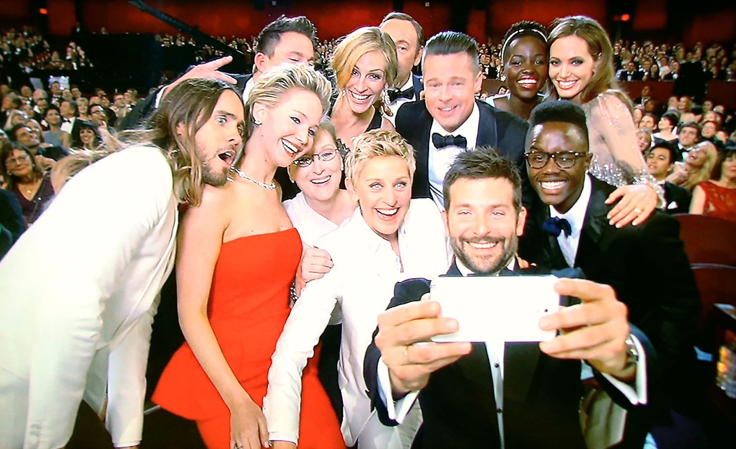
Story
Notes:
For example, in Oscar!
( made some joke from Samsung)

Slide 3
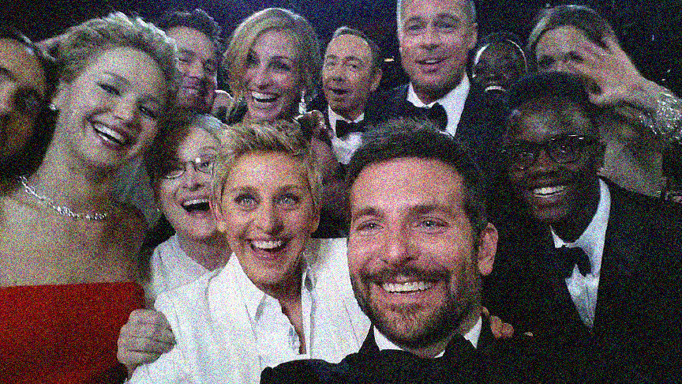
Notes:
But mobile camera is usually not that great. The lens is not as well constructed as normal camera because of the cost. The aperture is very small. And the sensor is even much smaller. Physically, a mobile camera cannot gather light as good as a normal camera. The image itself can be very noisy. (mentioned I added noise)
To solve this problem, using the properties of self-similarity and collaborative filtering, for example, BM3D and Nonlocal Mean, is the most effective way to remove the noise.
How do self-similarity and collaborative filtering remove the noise?
First, we have to understand what self-similarity structure is.
Let’s look at Bradley Cooper’s eye closely.

Slide 4
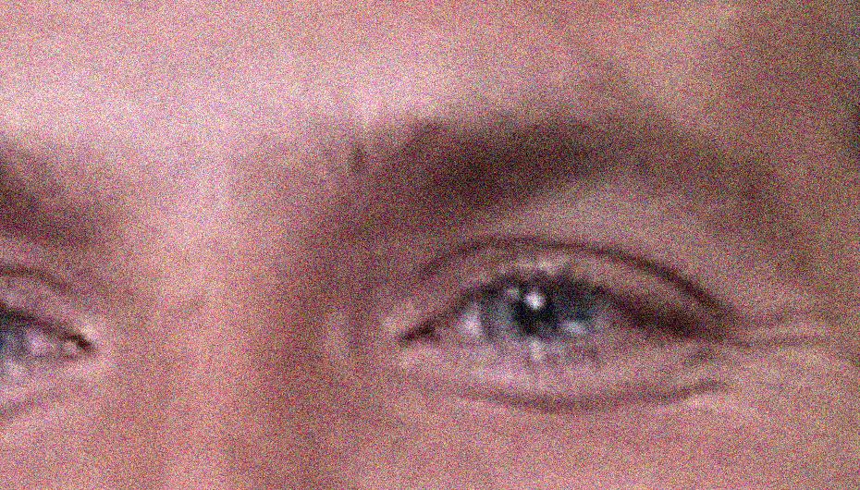


Notes:
Take the red square as the reference patch, there are a lot of the patches that also look very similar. We can see this kind of repeated texture pattern everywhere. This is called self-similarity structure. Self-similarity is one of the most important properties in image processing.

Slide 5

Notes:
Jointly, these similar patches give us an estimate how the reference patch suppose to look like.

Slide 6
Collaborative Filtering - Aggregation
•
Notes:
Another aspect is collaborative filtering. What does it mean? Let’s look at the center pixel of the red patch. There are lots of patches potentially overlapping this pixel. Collectively, each overlapping patch contributes filtered result to this pixel. Averaging these results gives you reliable reconstruction. Because each filtered patch also passes the information to other overlapping pixels, it is a collaborative process and where collaborative filtering comes from.

Slide 7
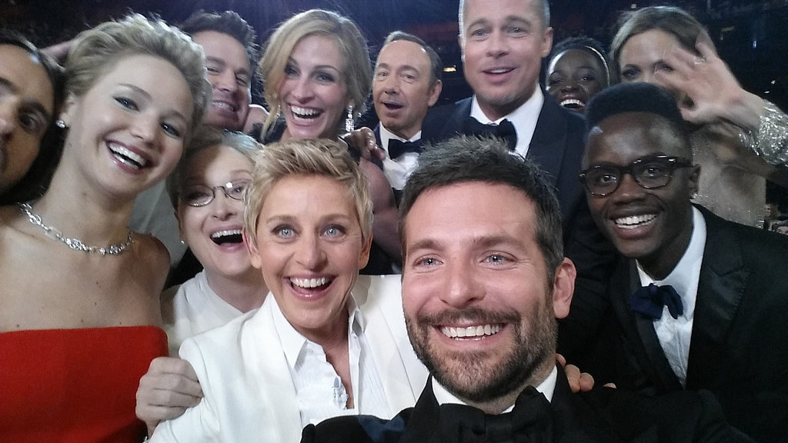
Collaborative Filtering - Result
Notes:
Doing the process for every single pixel generates a noise free image. Now I hope you have understood two important concepts: self-similarity and collaborative filtering. This is the foundation why we can make our algorithm fast and remain effective.
That being said, collaborative filtering is extremely computational intensive, especially searching for similar patches.
On NLM, nearest neighborhood search contributes to more than 80% of time. Solving nearest neighborhood problem allows collaborative filtering to be applied on many performance critical applications.

Slide 8
Collaborative Filtering - Result
Notes:
Doing the process for every single pixel generates a noise free image. Now I hope you have understood two important concepts: self-similarity and collaborative filtering. This is the foundation why we can make our algorithm fast and remain effective. Of course, collaborative filtering can also apply to many other applications which we will show later.
That being said, collaborative filtering is extremely computational intensive, especially searching for similar patches.
On NLM, nearest neighborhood search contributes to more than 80% of time. Solving nearest neighborhood problem allows collaborative filtering to be applied on many performance critical applications.

Slide 9
Related Work
Notes:
Many nearest neighborhood search algorithms have been proposed: either exact or approximated search.
For instance, the FLANN library consists many efficient ANN algorithms on both CPU and GPU that have been widely used for benchmark.
Here we are going to show the 3 recent works on the GPU that are the most related to us.

Slide 10
Distance Table
Distance Table (sorted)
0.13 | 1.43 | 0.98 | 1.33 | 1.21 | 2.33
0.13 | 0.98 | 1.21 | 1.33 | 1.43 | 2.33
1.22 | 0.31 | 0.45 | 2.01 | 1.75 | 0.48
0.31 | 0.45 | 0.48 | 1.22 | 1.75 | 2.01
0.21 | 0.33 | 0.92 | 1.12 | 2.11 | 3.16
2.11 | 1.12 | 0.92 | 3.16 | 0.33 | 0.21
Garcia et al. ICIP 2010
Notes:
Garcia et al presents an efficient implementation that compute and sort the distance table for each query in parallel. (break animation and explain the each step)

Slide 11
Cayton et al. ADMS 2010
Notes:
Cayton et al presents a fast clustering method to group data into multiple random spheres. (click)
At query step, algorithm will determine the closest sphere to avoid exhaustive search.

Slide 12
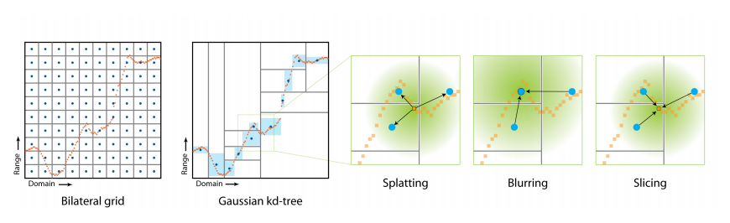
Adams et al. SIGGRAPH 2009
Notes:
Adams et al exploits the fact that most image processing filter can be formulated in Gaussian distribution. (explained the graph a little bit better, how does quantization work in general)
<click>
This allows data being quantized efficiently into KD-Tree
<click>
while supporting several fast operators: spallting, blurring and slicing, that are tailored for image processing.

Slide 13
Limitation
Notes:
However, all the previous methods have several limitations when dealing with high resolution images.

Slide 14

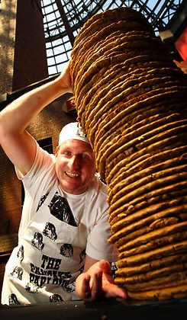
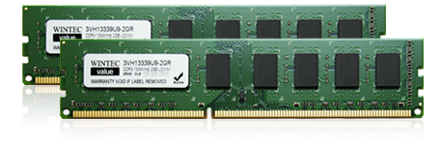
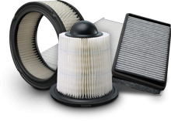
Notes:
Constructing cost of the data structure can be very expensive. Imagine that we need to index and query millions of patches for every frame. <click>
High dimensionality curse is also a problem. Many of the schemes have poor performance on high dimensional data. In our case, we constantly need to deal with 64D or more. <click>
They also have large memory footprint. Not all the computers have abundant of memory, such as your phone. Especially implementing this algorithm on the camera driver, we only have 5 to 20MBytes of memory budget because a mobile device also has many other things to run, not just the camera. <click>
Finally, some of the previous work is hard to integrate into different filters. Therefore it is difficult to switch types of filtering, such as weighted averaging or frequency analysis, for targeting applications. <click>

Slide 15
Our solution
Notes:
Our solution has none of these problems.

Slide 16
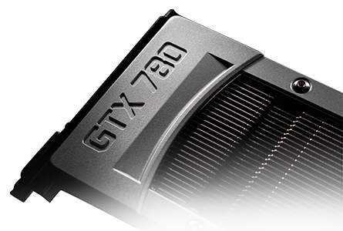
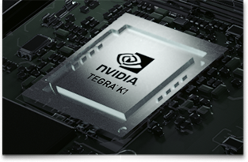
Our solution
Efficient implementation on GPU
General solution for different filters
High image quality
Applicable to different applications
Notes:
At the same time, we provide efficient and scalable implementation on GPUs, running on both desktop and mobile devices. <click>
Our approach is general and applicable to all types of filters. <click>
Most importantly, we maintain the high image quality. <click>
Finally, our solution can be adapted to other applications, such as burst denoising, global illumination and geometry reconstruction. <click>

Slide 17
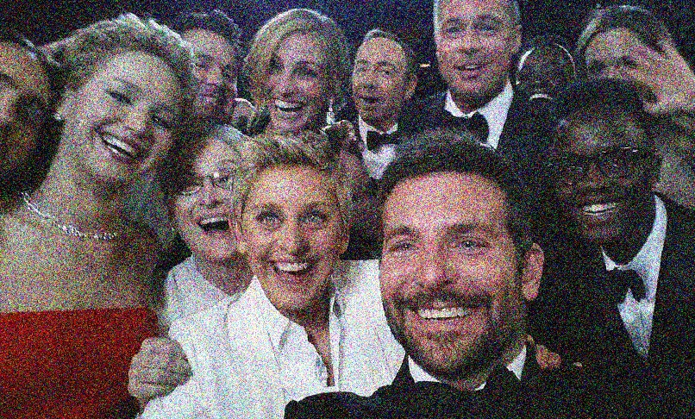
Our solution
Notes:
Here we are going to explain our solution.
On a high level, we split an image into tiles. <click>
For each tile, there are three main steps:
Clustering the image tiles into small clusters. <click>
Performing kNN query within each cluster. <click>
Finally, filtering and aggregating the patches to form the output image. <click>

Slide 18
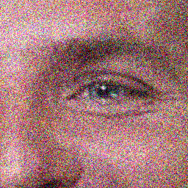
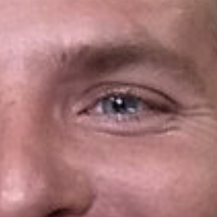
Our solution
Clustering
kNN Query
Filtering
Notes:
Here we are going to explain our solution.
On a high level, we split an image into tiles. <click>
For each tile, there are three main steps:
Clustering the image tiles into small clusters. <click>
Performing kNN query within each cluster. <click>
Finally, filtering and aggregating the patches to form the output image. <click>

Slide 19

Design challenges
Register pressure
Memory access pattern
Thread divergence
Kernel launch overhead
Memory footprint
Notes:
There are five major challenges driving the design of our solution: (quantization some of the challenges)
Reducing register pressure when dealing with high dimensional data.
Maximizing memory locality, especially similar patches may be far apart.
Minimizing thread divergence
Kernel launch overhead
And memory footprint.

Slide 20
Our solution
Clustering
kNN Query
Filtering
Notes:
Now we are going to dive into each stage of the pipeline and discuss how we solve those challenges. Let’s start with clustering.

Slide 21
Tiling
•
•
Notes:
Clustering is done on the per tile basis. This allows us to design an algorithm that is more parallelizable.
One might think that we would have problem at the tile boundary, because there are also very similar patches on the other side of the tile.
However, because patches are overlapping, each pixel will receive multiple estimation at the tile border.
For example, this green patch at the corner of the tile, each pixel within the overlapping region will also receive the estimation from the blue patch that belongs to the adjacent tile. Each pixel within the blue patch itself is benefit from the self-similarity structure within its own tile.
Jointly, this allows pixels at the tile boundary exploit self-similarity structure from the other side of the border.

Slide 22
Clustering
Notes:
We construct 1D array points to the center of each patch. (sliding window and pop-up the point).

Slide 23
Clustering
Notes:
Then we perform hierarchical 2-mean clustering, which can be efficiently implemented on GPU, until the cluster size falls under certain threshold.
Direct implementation of the clustering algorithm is not very efficient. Inherently, clustering is an irregular and diverging task in both memory and instruction.
We utilize shfl instructions, which allows us to exchange data between threads within a warp without using shared memory.

Slide 24
Warp-wide operation
3 | 8 | 2 | 6 | 3 | 9 | 1 | 4
Notes:
For example, a prefix sum of an array can be performed this way. <click> (explain a bit more what prefix sum is)
The benefit of doing warp-wide operation includes:
reducing register use
better parallelism
minimize thread and memory divergence
We use this technique throughout our pipeline and is major factor of speedup.

Slide 25
Warp-wide operation
3 | 8 | 2 | 6 | 3 | 9 | 1 | 4
3 | 8 | 2 | 6 | 3 | 9 | 1
Notes:
For example, a prefix sum of an array can be performed this way.
The benefit of doing warp-wide operation includes:
reducing register use
better parallelism
minimize thread and memory divergence
We use this technique throughput our pipeline and is major factor of speedup.

Slide 26
Warp-wide operation
3 | 11 | 10 | 8 | 9 | 12 | 10 | 5
Notes:
For example, a prefix sum of an array can be performed this way.
The benefit of doing warp-wide operation includes:
reducing register use
better parallelism
minimize thread and memory divergence
We use this technique throughput our pipeline and is major factor of speedup.

Slide 27
Warp-wide operation
3 | 11 | 10 | 8 | 9 | 12 | 10 | 5
3 | 11 | 10 | 8 | 9 | 12
Notes:
For example, a prefix sum of an array can be performed this way.
The benefit of doing warp-wide operation includes:
reducing register use
better parallelism
minimize thread and memory divergence
We use this technique throughput our pipeline and is major factor of speedup.

Slide 28
Warp-wide operation
3 | 11 | 13 | 19 | 19 | 20 | 19 | 17
Notes:
For example, a prefix sum of an array can be performed this way.
The benefit of doing warp-wide operation includes:
reducing register use
better parallelism
minimize thread and memory divergence
We use this technique throughput our pipeline and is major factor of speedup.

Slide 29
Warp-wide operation
3 | 11 | 13 | 19 | 19 | 20 | 19 | 17
3 | 11 | 13 | 19
Notes:
For example, a prefix sum of an array can be performed this way.
The benefit of doing warp-wide operation includes:
reducing register use
better parallelism
minimize thread and memory divergence
We use this technique throughout our pipeline and is major factor of speedup.

Slide 30
Warp-wide operation
3 | 11 | 13 | 19 | 22 | 31 | 32 | 36
Reduce register usage
Better parallelism
Minimize thread and warp divergence
Notes:
For example, a prefix sum of an array can be performed this way.
The benefit of doing warp-wide operation includes:
reducing register use
better parallelism
minimize thread and memory divergence
We use this technique throughout our pipeline and is major factor of speedup.

Slide 31
Clustering
kNN
kNN
kNN
kNN
Notes:
Back to our 1D array. Now it is arranged into multiple clusters.
Because all the reference patches are within the cluster, we can perform kNN search directly for each individual cluster, which is essentially the second stage of pipeline.
(split up the cluster with bracket say kNN)

Slide 32
Our solution
Clustering
kNN Query
Filtering
Notes:
Now we are ready to explain the query step. As mentioned earlier, we conduct kNN search for each cluster.
The essential part of kNN query is the computation of pair-wise distances between patches in order to find the best k candidates. Let’s see how to do it efficiently.

Slide 33
Our solution
Clustering
kNN Query
Filtering
Notes:
Now we are ready to explain the query step. As mentioned earlier, we conduct kNN search for each cluster.
The essential part of kNN query is the computation of pair-wise distances between patches in order to find the best k candidates. Let’s see how to do it efficiently.

Slide 34
kNN Query
kNN
kNN
kNN
kNN
Notes:
To save computation, we construct a distance table for each cluster. <click>
(explain what does distance table mean here, e.g. Specifically, we compute distance for every patch within a cluster with every other patch in this cluster.)
Because distance function is communicative, only half of the entries needs to be computed.
With this table, we can essentially find the final k candidates, which is equivalent of finding the smallest k entries for each row. <click>

Slide 35
kNN Query
p⁰
p¹
p²
p³
p⁴
p⁰
p¹
kNN
p²
p⁰
p¹
p²
p³
p⁴
p³
p⁴
Notes:
To save computation, we construct a distance table for each cluster. <click>
(explain what does distance table mean here, e.g. Specifically, we compute distance for every patch within a cluster with every other patch in this cluster.)
Because distance function is communicative, only half of the entries needs to be computed.
With this table, we can essentially find the final k candidates, which is equivalent of finding the smallest k entries for each row. <click>

Slide 36
kNN Query
p⁰
p¹
p²
p³
p⁴
p⁰
p¹
kNN
p²
p⁰
p¹
p²
p³
p⁴
p³
p⁴
Notes:
To save computation, we construct a distance table for each cluster. <click>
(explain what does distance table mean here, e.g. Specifically, we compute distance for every patch within a cluster with every other patch in this cluster.)
Because distance function is communicative, only half of the entries needs to be computed.
With this table, we can essentially find the final k candidates, which is equivalent of finding the smallest k entries for each row. <click>

Slide 37
kNN Query
p⁰
p¹
p²
p³
p⁴
p⁰
0.0 | 0.4 | 1.3 | 0.9 | 0.7
kNN
p⁰
p¹
p²
p³
p⁴
Notes:
Let’s look at one of the row in the distance table closely.
Instead of sorting each row, we found the most efficient way to find the smallest k entries is voting. (explain what the distance table a bit)
We let the whole entry compare against one constant value, if it is smaller than or equal to the this value, the result is 1, otherwise 0.
By counting the number of 1s, we know how many entries satisfy this condition. If the number of 1s is equal to k, then we are done!
How do we decide the constant values we want to try? All you need to do is to try out every possible entry in the same row. That will give you the answer.

Slide 38
kNN Query
p⁰
p¹
p²
p³
p⁴
p⁰
0.0 | 0.4 | 1.3 | 0.9 | 0.7
1 | 1 | 0 | 0 | 1
≤ 0.8
Notes:
Instead of sorting each row, we found the most efficient way to find the smallest k entries is voting.
Let’s look at one of the row in the distance table closely.
We let the whole entry compare against one constant value, if it is smaller than or equal to the this value, the result is 1, otherwise 0.
By counting the number of 1s, we know how many entries satisfy this condition. If the number of 1s is equal to k, then we are done!
How do we decide the constant values we want to try? All you need to do is to try out every possible entry in the same row. That will give you the answer. (put the arrow)

Slide 39
kNN Query
p⁰
p¹
p²
p³
p⁴
p⁰
0.0 | 0.4 | 1.3 | 0.9 | 0.7
1 | 0 | 0 | 0 | 0
≤ 0.0
Notes:
Instead of sorting each row, we found the most efficient way to find the smallest k entries is voting.
Let’s look at one of the row in the distance table closely.
We let the whole entry compare against one constant value, if it is smaller than or equal to the this value, the result is 1, otherwise 0.
By counting the number of 1s, we know how many entries satisfy this condition. If the number of 1s is equal to k, then we are done!
How do we decide the constant values we want to try? All you need to do is to try out every possible entry in the same row. That will give you the answer.

Slide 40
kNN Query
p⁰
p¹
p²
p³
p⁴
p⁰
0.0 | 0.4 | 1.3 | 0.9 | 0.7
1 | 0 | 0 | 0 | 0
≤ 0.0
1 | 1 | 0 | 0 | 0
≤ 0.4
Notes:
Instead of sorting each row, we found the most efficient way to find the smallest k entries is voting.
Let’s look at one of the row in the distance table closely.
We let the whole entry compare against one constant value, if it is smaller than or equal to the this value, the result is 1, otherwise 0.
By counting the number of 1s, we know how many entries satisfy this condition. If the number of 1s is equal to k, then we are done!
How do we decide the constant values we want to try? All you need to do is to try out every possible entry in the same row. That will give you the answer.

Slide 41
kNN Query
p⁰
p¹
p²
p³
p⁴
p⁰
0.0 | 0.4 | 1.3 | 0.9 | 0.7
1 | 0 | 0 | 0 | 0
≤ 0.0
1 | 1 | 0 | 0 | 0
≤ 0.4
1 | 1 | 1 | 1 | 1
≤ 1.3
Notes:
Instead of sorting each row, we found the most efficient way to find the smallest k entries is voting.
Let’s look at one of the row in the distance table closely.
We let the whole entry compare against one constant value, if it is smaller than or equal to the this value, the result is 1, otherwise 0.
By counting the number of 1s, we know how many entries satisfy this condition. If the number of 1s is equal to k, then we are done!
How do we decide the constant values we want to try? All you need to do is to try out every possible entry in the same row. That will give you the answer.

Slide 42
kNN Query
p⁰
p¹
p²
p³
p⁴
p⁰
0.0 | 0.4 | 1.3 | 0.9 | 0.7
1 | 0 | 0 | 0 | 0
≤ 0.0
1 | 1 | 0 | 0 | 0
≤ 0.4
1 | 1 | 1 | 1 | 1
≤ 1.3
1 | 1 | 0 | 1 | 1
≤ 0.9
Notes:
Instead of sorting each row, we found the most efficient way to find the smallest k entries is voting.
Let’s look at one of the row in the distance table closely.
We let the whole entry compare against one constant value, if it is smaller than or equal to the this value, the result is 1, otherwise 0.
By counting the number of 1s, we know how many entries satisfy this condition. If the number of 1s is equal to k, then we are done!
How do we decide the constant values we want to try? All you need to do is to try out every possible entry in the same row. That will give you the answer.

Slide 43
kNN Query
p⁰
p¹
p²
p³
p⁴
p⁰
0.0 | 0.4 | 1.3 | 0.9 | 0.7
1 | 0 | 0 | 0 | 0
≤ 0.0
1 | 1 | 0 | 0 | 0
≤ 0.4
1 | 1 | 1 | 1 | 1
≤ 1.3
1 | 1 | 0 | 1 | 1
≤ 0.9
1 | 1 | 0 | 0 | 1
≤ 0.7
Notes:
Instead of sorting each row, we found the most efficient way to find the smallest k entries is voting.
Let’s look at one of the row in the distance table closely.
We let the whole entry compare against one constant value, if it is smaller than or equal to the this value, the result is 1, otherwise 0.
By counting the number of 1s, we know how many entries satisfy this condition. If the number of 1s is equal to k, then we are done!
How do we decide the constant values we want to try? All you need to do is to try out every possible entry in the same row. That will give you the answer.

Slide 44
kNN Query
p⁰
p¹
p²
p³
p⁴
p⁰
0.0 | 0.4 | 1.3 | 0.9 | 0.7
1 | 0 | 0 | 0 | 0
≤ 0.0
1 | 1 | 0 | 0 | 0
≤ 0.4
1 | 1 | 1 | 1 | 1
≤ 1.3
1 | 1 | 0 | 1 | 1
≤ 0.9
1 | 1 | 0 | 0 | 1
≤ 0.7
Notes:
Instead of sorting each row, we found the most efficient way to find the smallest k entries is voting.
Let’s look at one of the row in the distance table closely.
We let the whole entry compare against one constant value, if it is smaller than or equal to the this value, the result is 1, otherwise 0.
By counting the number of 1s, we know how many entries satisfy this condition. If the number of 1s is equal to k, then we are done!
How do we decide the constant values we want to try? All you need to do is to try out every possible entry in the same row. That will give you the answer.

Slide 45
kNN Query
kNN
p⁰
p¹
p²
p³
p⁴
11011
11101
01111
11101
11110
Notes:
The byproduct of the voting is binary coding of the kNN candidates for each patch. We can use it to represent our candidate list concisely.
Now, each patch will have an associated bits to represent the candidates. Once we have the candidate lists, we can efficiently perform filtering for each cluster. (explain a bit with one more slide about filtering and aggregation)

Slide 46
Filtering
Notes:
Fundamentally, the difference between conventional filtering approach and ours is that we reuse nearest candidates to filter clusters jointly.
For example, traditional sliding window approach would search similar patches for each reference patch, filter and then discard that candidate information. Repeat.
However, you would notice that, in fact, a lot of same candidate patches s are repeatedly used.
Therefore, we make the process more efficient by searching candidates and then filter for each cluster at once.

Slide 47
Our solution
Clustering
Clustering
Hierarchical 2-mean clustering
Warp-wide operators
kNN search
Distance table
Voting
Binary coding
Filtering and aggregation
kNN Query
kNN Query
Filtering
Filtering
Notes:
To recap the techniques of our solution:
We clustered a 1D array of each tile with hierarchical 2-mean clustering.
To make such implementation very efficient, warp-wide operators are used. <click>
Once the array is clustered, we conduct kNN search within each cluster.
To save computation, we precomputed the distance table and used voting.
The byproduct of the voting result is compact binary coding that can represent candidate lists. <click>
Finally, we performed desired filtering and aggregation within each cluster.
We transformed the algorithm from highly irregular to highly parallelizable. Please read our paper for further detail.

Slide 48
Results
Notes:
Now we have explained our pipeline. Let’s see the results.

Slide 49
NN quality
Notes:
Here we show the percent of patches match the exact kNN result. 100% would indicate an exact search. The higher the bar, the better. (ratio instead of percent)
For fair comparison, we split images into tiles, and ask each algorithm to perform nearest neighborhood search on the per tile basis. It gives all the algorithms o have the same data to be searched.
On average we are competitive to other methods. Our algorithm returns 40% of correct candidates comparing with exhaustive search.
While Random Ball Cover is much more precise, in our experiments its accuracy drops significantly with increase of tile size wherea ours preserve the accuracy.

Slide 50
NN quality
Notes:
Here we show the ratio of sum of L2 distances between each approximated search algorithm and exact search. Therefore, the ratio is greater or equal to 1. The lower the bar, the closer to the ground truth. (make the Dann / Dknn more understandable)
Our method is quite competitive, about 30% worse than the exact search.
Note that our method is performing better than K-means in both cases.
This is because we only performs hierarchical binary clustering. It gives us better separation between background and foreground, and reduce the influence of outliers. <click>

Slide 51
Single Frame Noise Reduction
Notes:
Meanwhile, our proposed algorithm maintains high image quality in both nonlocal mean (the higher of the bar, the better of the quality), <click>
and BM3D. Especially BM3D, our method out performs Random Ball Cover and is almost as good as exhaustive search.
This is because Nonlocal Mean uses weighted average w.r.t. the L2 distance between reference and candidate patches, which reflects the accuracy of search.
On the other hand, BM3D does not require very good matches because it uses frequency analysis (for examples, DCT and Haar) that de-correlates noise from the signal better.
In fact, exact match would create match noise-to-noise scenario which lower the performance.
This also explains that why Random Ball Cover can perform better in Nonlocal Mean and worse in BM3D.

Slide 52
Single Frame Noise Reduction
Notes:
Meanwhile, our proposed algorithm maintains high image quality in both nonlocal mean (the higher of the bar, the better of the quality), <click>
and BM3D. Especially BM3D, our method out performs Random Ball Cover and is almost as good as exhaustive search.
This is because Nonlocal Mean uses weighted average w.r.t. the L2 distance between reference and candidate patches, which reflects the accuracy of search.
On the other hand, BM3D does not require very good matches because it uses frequency analysis (for examples, DCT and Haar) that de-correlates noise from the signal better.
In fact, exact match would create match noise-to-noise scenario which lower the performance.
This also explains that why Random Ball Cover can perform better in Nonlocal Mean and worse in BM3D.

Slide 53
Single Frame Noise Reduction
Notes:
Here, we compared our run-time against algorithms on CPU. For each algorithm we have tried to find the best parameters for performance and quality.
Our solution is still orders of magnitude faster. (quantify how much faster)

Slide 54
Single Frame Noise Reduction
Notes:
Comparing with recent work on GPU, our solution is much faster in both construction and query.
Note that both kNN-Garcia and Random Ball Cover methods take much longer time in clustering even thought query can be executed very fast. We can achieve almost the same or better image quality in much shorter period. (quantify how much faster)
We also optimized window search with warp-wide operation mentioned earlier. This demonstrates how much speed-up you can get with this technique.

Slide 55
Architectures
Notes:
We also have ported our algorithm to Core –i7 Nehalem and Tegra K1. Note that our algorithm on Tegra K1 has much better Perf/Watt against desktop class processors.

Slide 56
Burst Denoising – Single Frame
Notes:
We also extended our work to spatial-temporal filtering. For example, we can support burst denoising using multiple frames in a stack.
Here is the first frame of the stack with 16 images corrupted by the noise with sigma=20.

Slide 57
Burst Denoising – Single Frame
Notes:
Looking closely, we can see a lot of noise. <click and click>

Slide 58
Burst Denoising – Single Frame
Notes:
The result from Gaussian KD-Trees is 31.01dB. It takes 11 seconds to compute. <click>
Our approach is almost 1dB higher, and it also takes much less time, about 0.02 second.
As you can see the structure of the window is clearly visible in our case. <click and click>

Slide 59
Burst Denoising – All Frames
Notes:
If we take all the 16 images into account, Gaussian KD-Trees performs slightly better but takes much longer time. <click>
While our noise reduction performs almost 3dB better and only takes half of a second.

Slide 60
Burst Denoising – All Frames
Notes:
Here shows the ground truth of the signal. We can see how close of our reconstruction is against the ground truth.

Slide 61
Global Illumination
Notes:
Our method can also apply to path tracing and filtered sparse sampled indirect illumination. We generates sparse indirect illumination with 4spp (sample-per-pixel), and direct illumination separately. Then we perform kNN query on the direct illumination, which is clean, and use that information to filter noisy indirect illumination.

Slide 62
Global Illumination
Notes:
Combining clean direct and filtered indirect illumination we get the final reconstruction. Here is our result reconstructing from 4spp.

Slide 63
Global Illumination
Notes:
Our method is comparable to 512spp but much faster.

Slide 64
Geometry Noise Reduction
Noisy Input
Notes:
We also applied our method to geometry noise reduction. We can achieve this via applying nonlocal mean on the detail layer of Laplacian smoothing.

Slide 65
Geometry Noise Reduction
Ours
Notes:
Here is our reconstruction result. <click and click>

Slide 66
Geometry Noise Reduction
Ours
Exhaustive Search
Notes:
Our result is almost identical to exhaustive search.

Slide 67
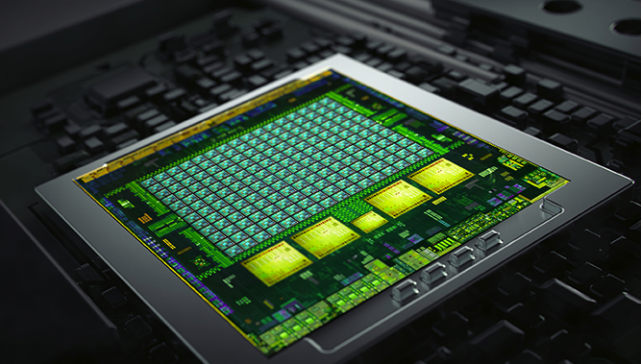
Conclusions
Efficient implementation on GPU
High image quality
Applicable to different applications
Notes:
(Recap why and how good we are)
In conclusion, we propose a GPU-friendly approximated-nearest-neighbor algorithm that produces high-quality results for any type of collaborative filter.
We evaluate our ANN search against state-of-the-art algorithms in several application domains.
Our method is orders of magnitudes faster, yet provides similar or higher-quality results than the previous work.
In the future, we would like to explore other applications such as: video processing, super resolution, etc.
Thank you for your attention.

Slide 68
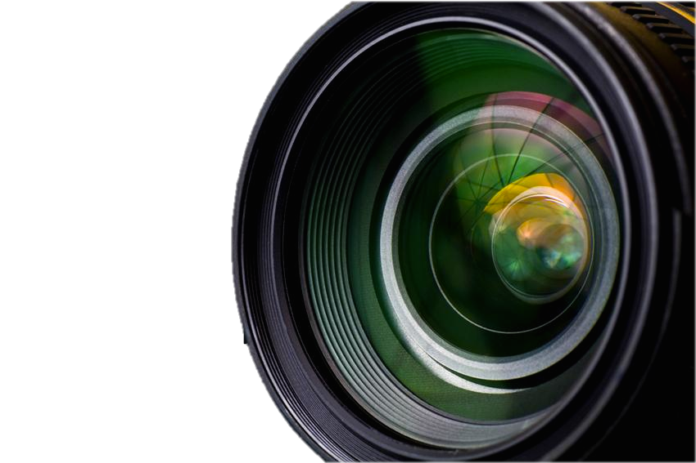
Thank you
Paper and Binary:
  http://bit.ly/fast-ann

