Slide 1
Apex Point Map for Constant-Time Bounding Plane Approximation
Samuli Laine
Tero Karras
NVIDIA

Slide 2
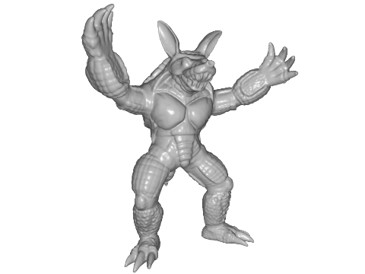
The Problem
How to quickly find a good bounding plane with a given orientation?

Slide 3
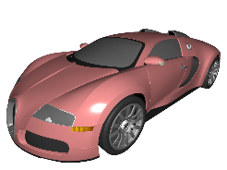
Use Case 1: Ray Tracing and Rigid Motion
Say we have a world-space BVH with leaves containing object ID + transformation matrix
Each object has a pre-built BVH in model space
When ray finds an object, it descends into per-model BVH

Slide 4
Use Case 1: Ray Tracing and Rigid Motion
When objects move and rotate, the world-space BVH needs to be rebuilt / refit, but per-object BVHs stay unchanged
Very fast
But: Where do we get the world-space AABBs for the transformed objects?

Slide 5
The Naïve Solution
Take the object’s model-space AABB
Transform it along with the object
Wrap a world-space AABB around it
Declare victory
Model space
World space

Slide 6
The Naïve Solution
Woefully conservative!
Stats for Armadillo:
Average = 94% larger surface area than for a tightly fit AABB
Worst case = +169% surface area
A spherical model is even worse
Average = +125% AABB area
Worst case = +179% AABB area
This kills the world-space BVH

Slide 7
A Better Solution
Start with world-space AABB normals
Take them to model space
Query tight bounding plane offsets
Apply in world space
Model space
World space

Slide 8
Use Case 2: View Frustum Culling
Both world-space AABB and transformed object-space AABB are suboptimal for view frustum culling
What we really want to know is whether a bounding plane oriented along frustum plane is inside the frustum or not
Eye

Slide 9
Use Case 3: Per-Object Shadow Map Extents
Directional light source
Choosing projection extents based on object bounding box wastes shadow map resolution
Tight bounding planes come to the rescue

Slide 10
Use Case 4: Collision Detection
Transformed object-space AABBs may intersect
Tightly fit world-space AABBs may intersect
But if you can guess a separating plane normal, it is very cheap to test
Could try, e.g., vector between object centers

Slide 11
Constraints
If we want the bounding plane fit to be fast, precalculation is unavoidable
Otherwise must loop over all* vertices
Mesh needs to be static
Except: See paper for extension to skinned meshes
* Vertices on the convex hull would obviously be enough, but then we’d need to precalculate the convex hull ☺

Slide 12
AABB: The Good
The amount of precalculated data is small and constant
The precalculation is fast and simple
Fitting an arbitrarily oriented bounding plane is really fast

Slide 13
AABB: The Bad
An arbitrarily oriented bounding plane fit to an AABB can be extremely conservative
HOWEVER
Fitting an axis-aligned plane works fine (exact result)
Fitting an almost axis-aligned plane is still okay-ish

Slide 14
More Is More
Why not precalculate a many- sided bounding volume?
This is known as a k-DOP
Intersection of half-spaces
k is the number of plane normals
AABB belongs to the 6-DOP family
Determining the k plane equations for a mesh is easy and fast
But…

Slide 15
The Trouble with k-DOPs
Determining the vertices of the k-DOP surface is non-trivial, to say the least
Known as the vertex enumeration problem in linear optimization circles
2D case looks deceptively simple, problems start at 3D

Slide 16
k-DOP Surface Topology Is Not Fixed
*
C
C
B
B
A
A
* Except when it is (e.g., in case of AABBs)

Slide 17
Apex Point Map
Start with a k-DOP, but instead of trying to find the k-DOP surface vertices, find some other vertices
These are what we call apex points
They may be k-DOP surface vertices, but possibly aren’t
In addition, choose k-DOP normals carefully so that we can easily decide a single apex point to fit the bounding plane against
Makes bounding plane construction extremely fast

Slide 18
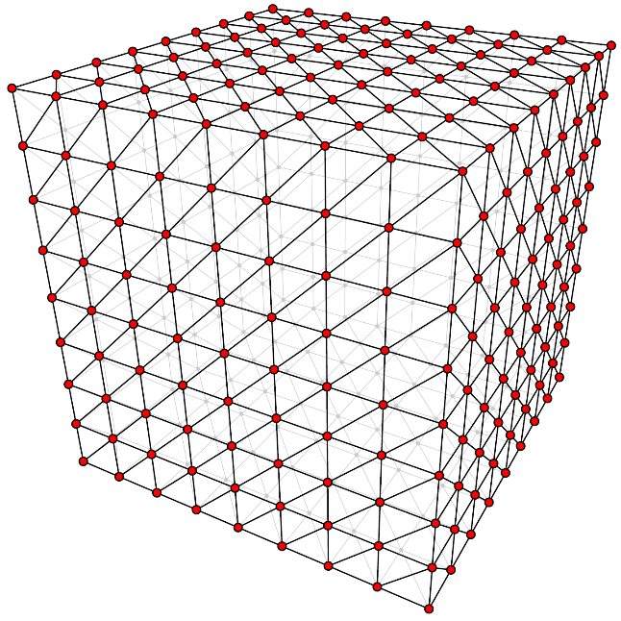
k-DOP Normals
We choose the k-DOP normals to point at the vertices of a regularly tessellated cube
With each face tessellated to n×n squares, we get 6n² + 2 normal directions
In this figure, n = 8 → k = 386

Slide 19
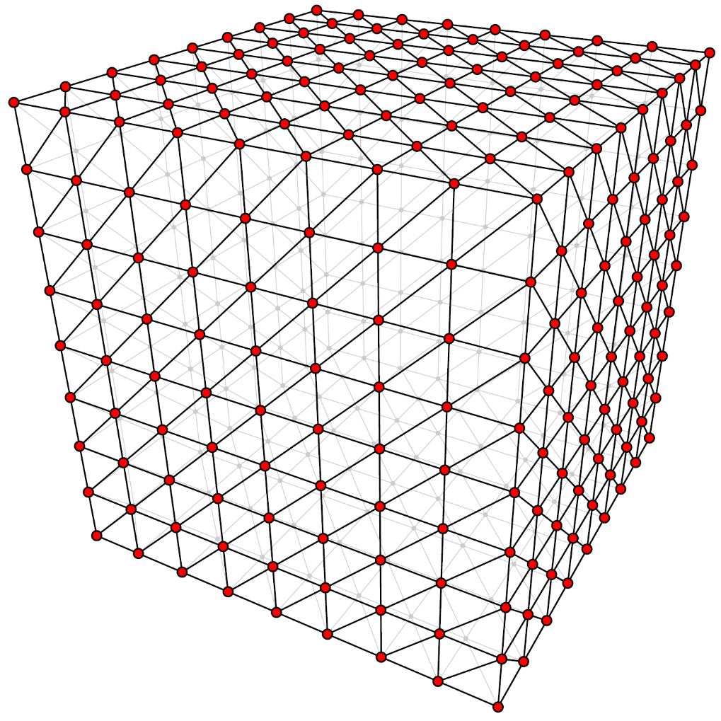
k-DOP Normals
The direction space is divided into triangular facets
Each facet covers the directions that are convex combinations of three k-DOP normal directions

Slide 20
Constructing the Apex Point
Apex point for this facet is the intersection of the k-DOP planes that were generated using the shown normals
Lies on the k-DOP surface iff corresponding k-DOP faces meet

Slide 21
Using the Apex Point
When fitting a bounding plane with normal in a given facet of direction space, set the plane offset so that it passes through the apex point for the facet

Slide 22
Why Does This Work?
k-DOP is an intersection of half-spaces → Taking any subset of k-DOP planes yields a valid conservative bound for the mesh
Taking three planes yields an infinite triangular pyramid
If we’re fitting a bounding plane, we can make it pass through the apex of the pyramid – if it can bound the pyramid at all, it will bound it there too
Plane bounds the pyramid, pyramid bounds the mesh → plane bounds the mesh

Slide 23
Summary of the Method
Precalculation:
Construct a k-DOP with normals according to tessellated cube
For each direction space facet, compute one apex point as the intersection of three k-DOP planes
Store these apex points, nothing else
To fit a bounding plane:
Find the facet that contains the plane normal direction
Fetch the apex point for the facet
Set plane offset so that it passes through the apex point

Slide 24
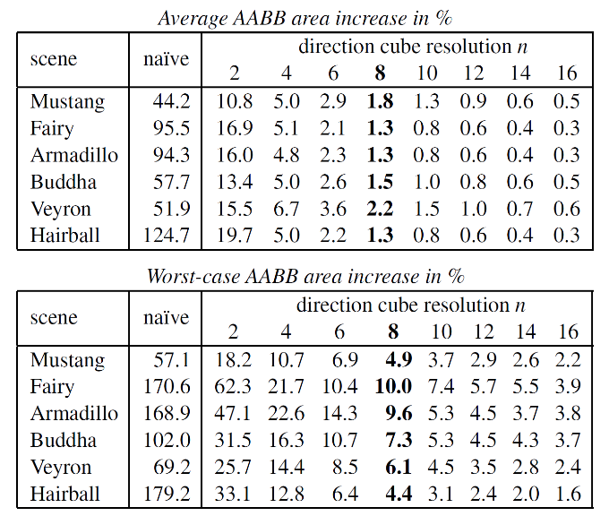
Results: Quality

Slide 25
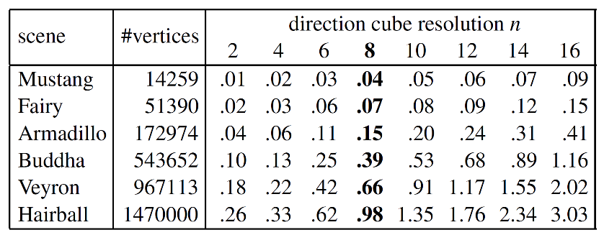
Results: Speed
For n=8, tops out at ~1.5M vertices / ms on NVIDIA GTX 980
Precalculated data consumes 9 KB / mesh for n=8

Slide 26
Conclusion
Don’t do this!
Do this

Slide 27
Conclusion
Eye
Mesh vs plane
Projection bounds
Object overlap

Slide 28
Thank You
Questions

