Slide 1
Adaptive temporal antialiasing
Adam Marrs, August 10th 2018
Notes:
Welcome, my name is Adam Marrs and I’m a Computer Scientist at NVIDIA.

Slide 2
“…the hardest problem in computer graphics is finding something that hasn’t already been done. That is your challenge.”
Jim Blinn, 1987
Notes:
Jim Blinn once said the hardest problem in computer graphics is finding something that hasn’t already been done. So, I’m going to talk about antialiasing (cue intense laughter)

Slide 3
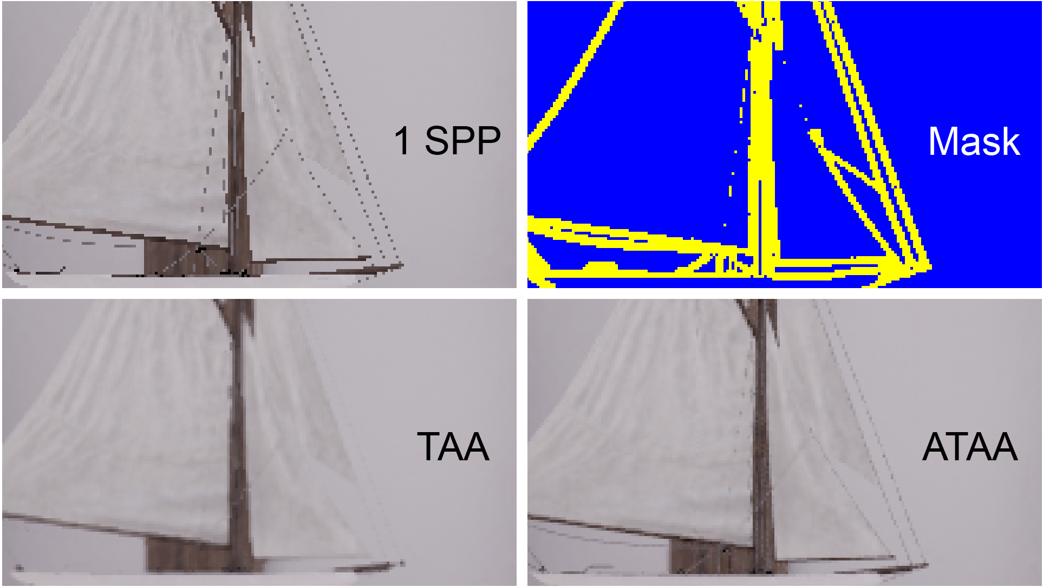
Notes:
As you all know, aliasing is a perennial problem in graphics. Today, I’ll introduce you to a new antialiasing approach that we call Adaptive Temporal Antialiasing.
In the figure here, you can see the output of our algorithm compared to 1spp rasterization and Temporal Antialiasing (TAA). Notice the improved sampling of sub-pixel geometry of the boat ropes in our result (on the right of the image), where TAA blurs away these features almost entirely.
Although it can’t be in this image, our method also completely eliminates ghosting and blurring artifacts typical to TAA.
This image also shows a failure case of our approach…can you spot it? I’ll talk about this in a bit.

Slide 4
The State of (Anti)aliasing in Real Time
Problem Space
Games limited to a low fixed sample counts (~1spp) at modest resolutions (< 4K)
Result: primary surfaces are undersampled and have unbounded error when material, geometric, or shading features exist between samples
Aliasing due to undersampling manifests as jagged edges, spatial noise, and flickering
Constraints: 8x supersampled image quality without ghosting/blurring on a real-time budget
Notes:
For those who might be new to real-time I’ll go over some background quickly, and then get to our work.
Real time applications, like games, are limited to low fixed sample counts at relatively modest resolutions. This causes primary surfaces to be undersampled.
Aliasing from undersampling manifests as jagged edges, spatial noise, and flickering.
Furthermore, due to the fixed 1spp sampling grid an adversary can always create unbounded error by placing material, geometric, or shading features between the fixed samples.
This makes our goal of 8x supersampled image quality without ghosting/or blurring very challenging on a real-time budget.

Slide 5
The State of (Anti)aliasing in Real Time
TAA All Day
Supersampling (SSAA): cost linearly proportional to the number of samples while only improving quality with the square root
Multisampling: MSAA, CSAA, SBAA [Salvi and Vidimce 2012], SRAA [Chajdas et al. 2011]
Aggregation: DCAA [Wang et al. 2015], AGAA [Crassin et al. 2016]
Spatial: MLAA [Reshetov 2009], FXAA [Lottes 2009]
Time: SMAA [Jimenez et al. 2012], TAA [Yang el al] [Karis 2014]
Current Best Practice: employ many strategies simultaneously, hand tune by artists [Pettineo 2015, Pedersen 2016], rely on TAA for the best !/$ solution
Notes:
There are many attempts to conceal aliasing errors using various reconstruction filters in space and time – but these come at the cost of adding blurring and/or ghosting artifacts
Supersampling and multi-sampling don’t have these issues but are usually too slow for AAA quality assets and lighting techniques.
The current best practice is to employ many of these strategies at once and hand tune by artists. Typically, this means a combination of TAA and FXAA.
Supersampling is too expensive for the quality improvement it delivers
Multisampling samples geometry, materials, and shading at varying rates to heuristically reduce the cost compared to supersampling – but still lowers quality.
Aggregation reduces AA costs more aggressively but still lowers quality.

Slide 6
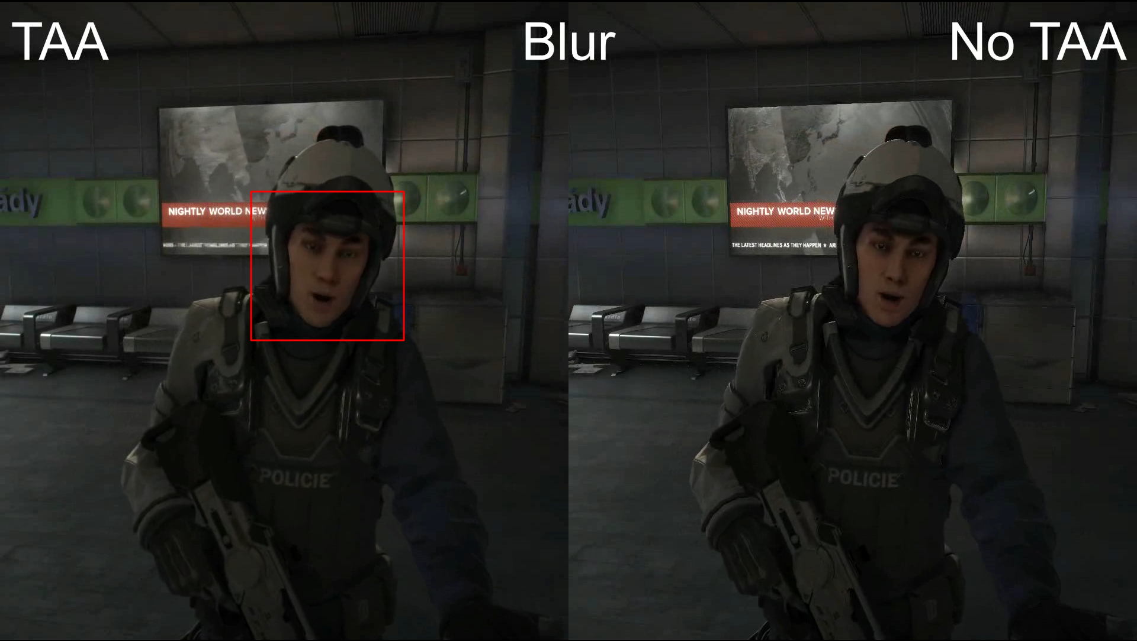
Deus Ex: Mankind Divided
© Eidos Montreal, Square Enix
Notes:
Here is a frame captured from Deus Ex: Mankind Divided from Eidos Montreal and Square Enix.
This is a great game – I captured this from my own Steam library – but it exhibits the classic pitfalls when using TAA.

Slide 7
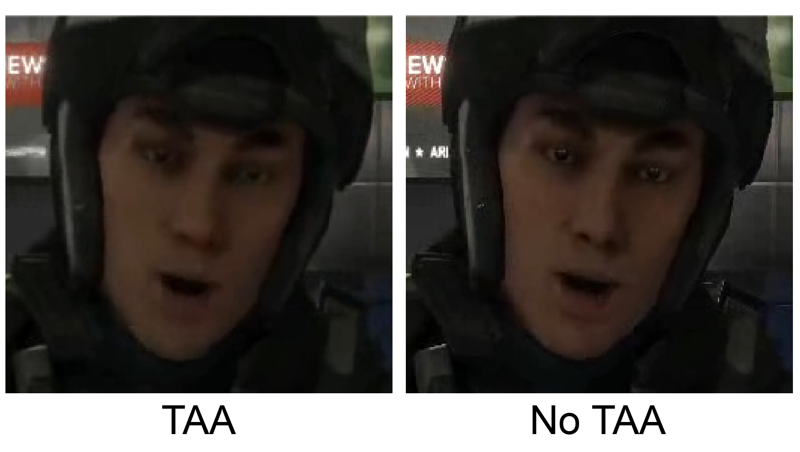
Notes:
The TAA result – shown on the left – is noticeably blurry compared to the image without TAA.

Slide 8
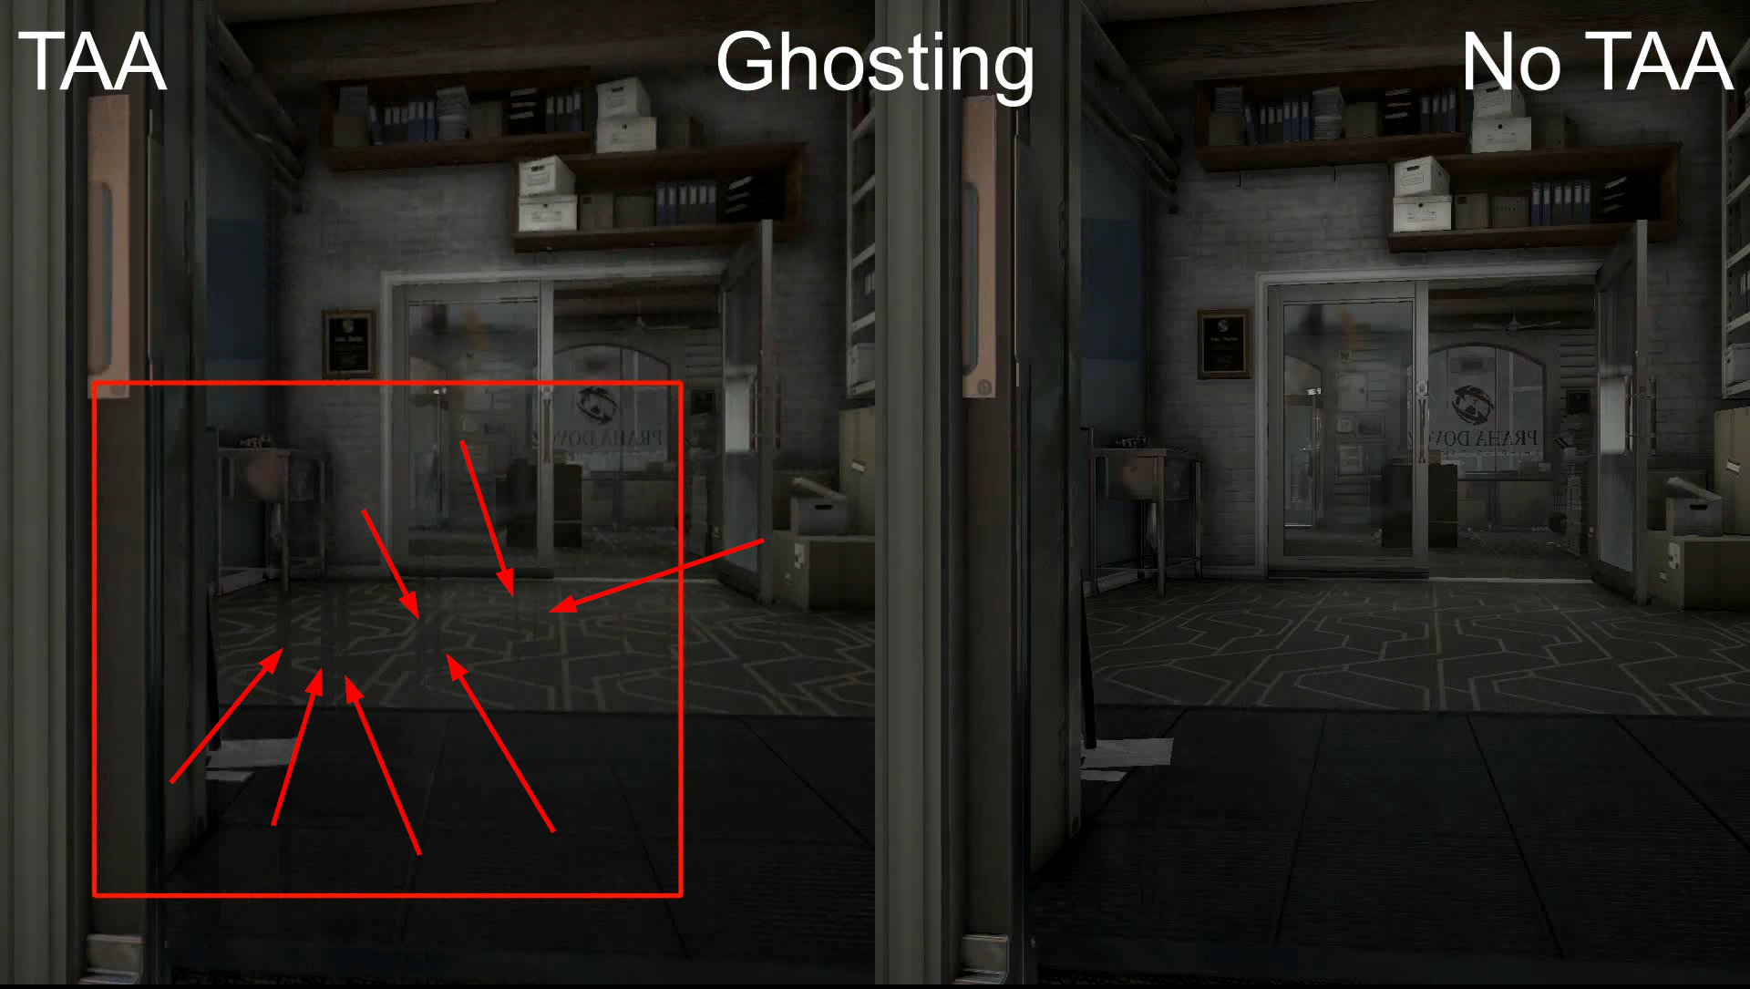
Deus Ex: Mankind Divided
© Eidos Montreal, Square Enix
Notes:
In addition to blur, ghosting is visible for fast moving objects – this door opening.
Data from previous frames is used in the current frame, but due the rapidly changing nature of each frame that previous data is no longer valid.

Slide 9
Finding A Practical Hybrid Algorithm
Redefining AA
Offline ray tracers use highly adaptive sample counts to resolve aliasing and bound error
Some real-time work in this area [Hollander et al. 2013], but still must rasterize all geometry
Previous hybrid ray and raster algorithms were impractical due to HW architectures & APIs
DXR and RTX enable full interoperability between ray and raster rendering on the GPU
Notes:
When thinking about the aliasing problem, we draw inspiration from offline ray tracers – which use adaptive sample counts.
Some work in this area has been done, but the key limiter is how dependent we are on rasterization.
Hybrid ray and raster algorithms have been proposed, but – at the time – were impractical due to the design of HW architectures & rendering APIs.
With the introduction of Microsoft DXR and NVIDIA RTX – this has changed. Full interoperability between ray and raster on the GPU has arrived.

Slide 10
Finding A Practical Hybrid Algorithm
Redefining AA
Naively ray tracing every pixel is too expensive
Find the pixels that will benefit most from supersampling, using the existing 1spp input
Goal: harness strengths of TAA while addressing its failures simply and unequivocally
Goal: work within the constraints of conventional game engines
Notes:
But – just because we can ray trace, doesn’t mean the problem is magically solved.
Naively ray tracing is still expensive. We need to identify the pixels that will benefit most from supersampling, and focus on those.
In accomplishing this, we laid out two main goals for ourselves.
First, harness the strengths of TAA – the existing state of the art – and address it’s failures simply and unequivocally. And second, work within the constraints of a real game engine.

Slide 11
Adaptive Temporal Antialiasing
Core Idea
We efficiently combine ray and raster, leverage adaptive sampling in the context of TAA
Step 1: Run TAA
Step 2: Compute a segmentation mask of where TAA fails, and why
Step 3: Replace complex post-failure TAA heuristics with robust alternatives: ray tracing
Step 4: Use segmentation mask to guide ray tracing adaptivity
Step 5: Enjoy!
Notes:
The core idea of adaptive temporal antialiasing is to efficiently combine ray and raster, while leveraging adaptive sampling in the context of TAA.
To do this we 1) run TAA and compute a segmentation mask where TAA fails, and why it fails. Many TAA algorithms, like the implementation in UE4 already estimate where TAA fails and then apply various strategies to deal with the failure.
We replace these TAA post-failure strategies with more robust alternatives, specifically: ray tracing.
The segmentation mask is used to guide the adaptivity of the ray tracing step.

Slide 12
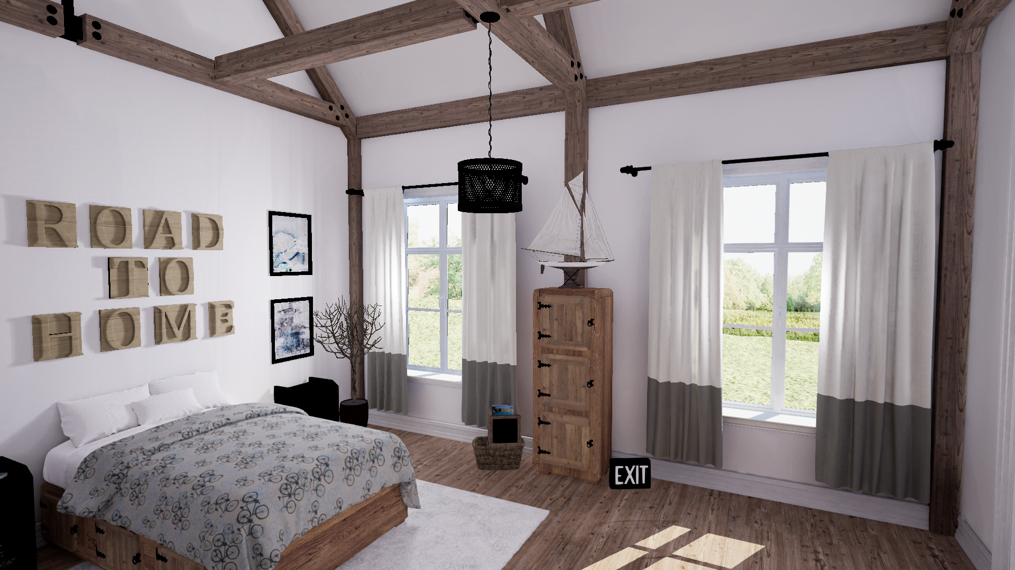
No AA
Notes:
Here is a 1spp raster scene output from UE4 – without any AA.

Slide 13
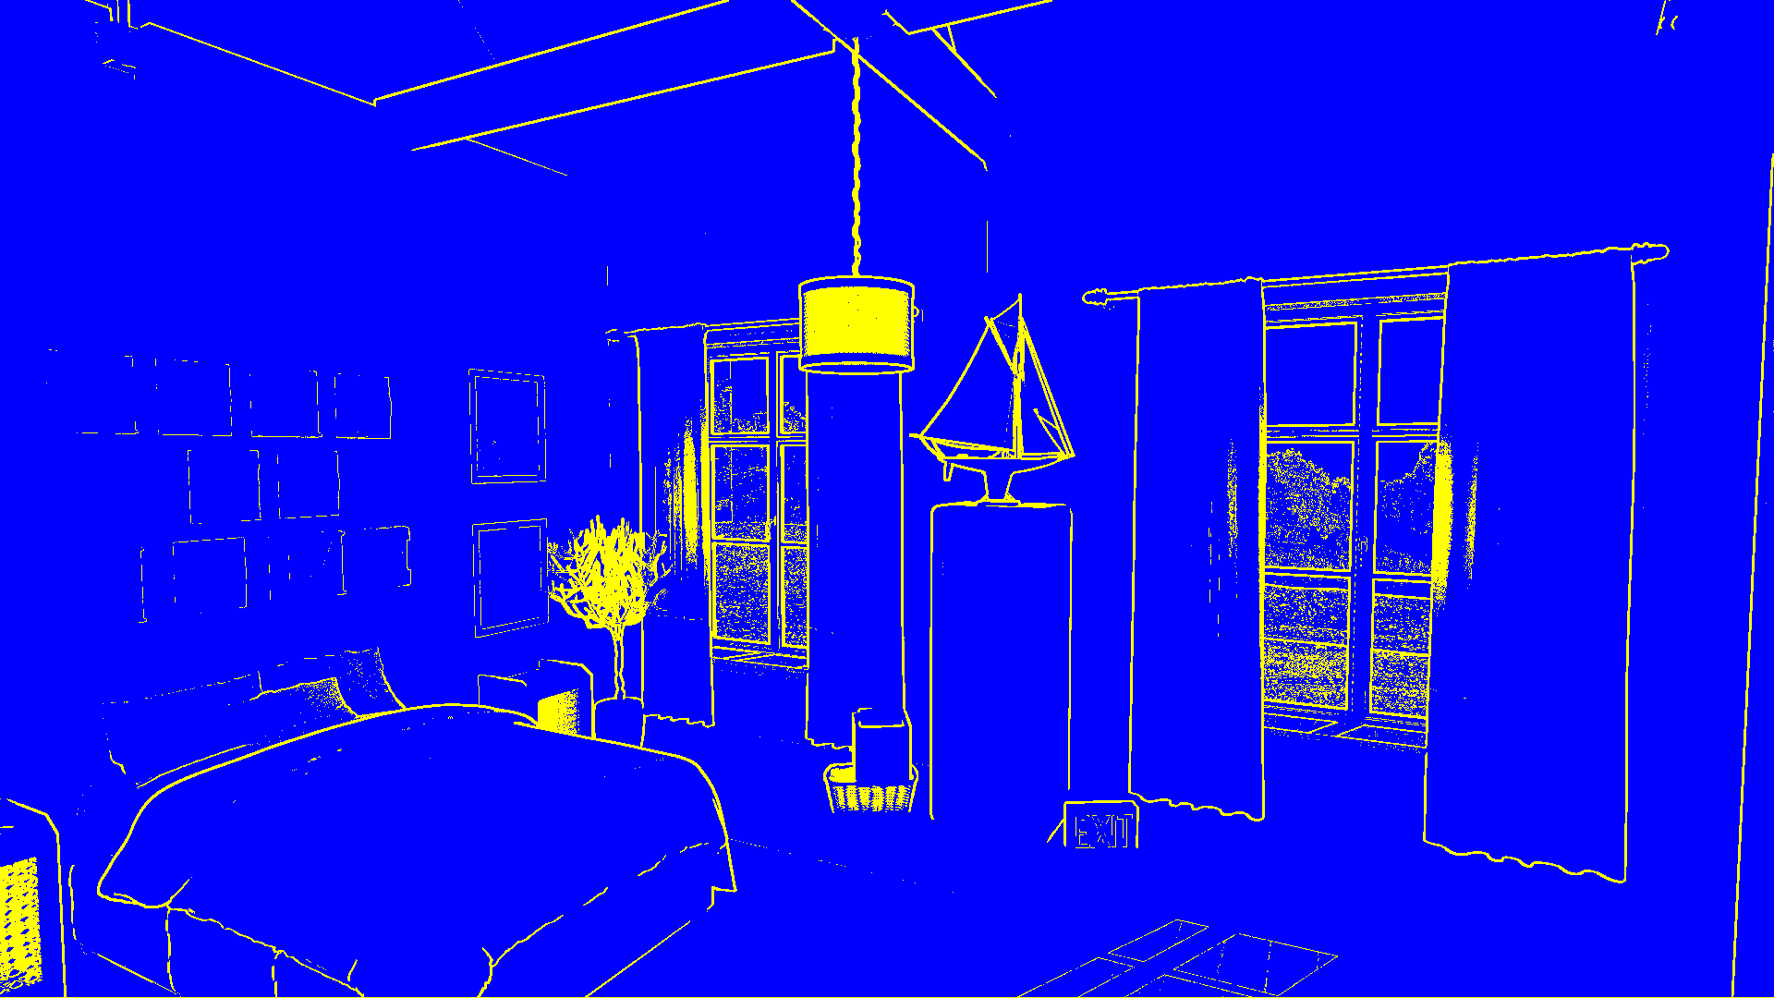
Notes:
This is the segmentation mask we compute.

Slide 14
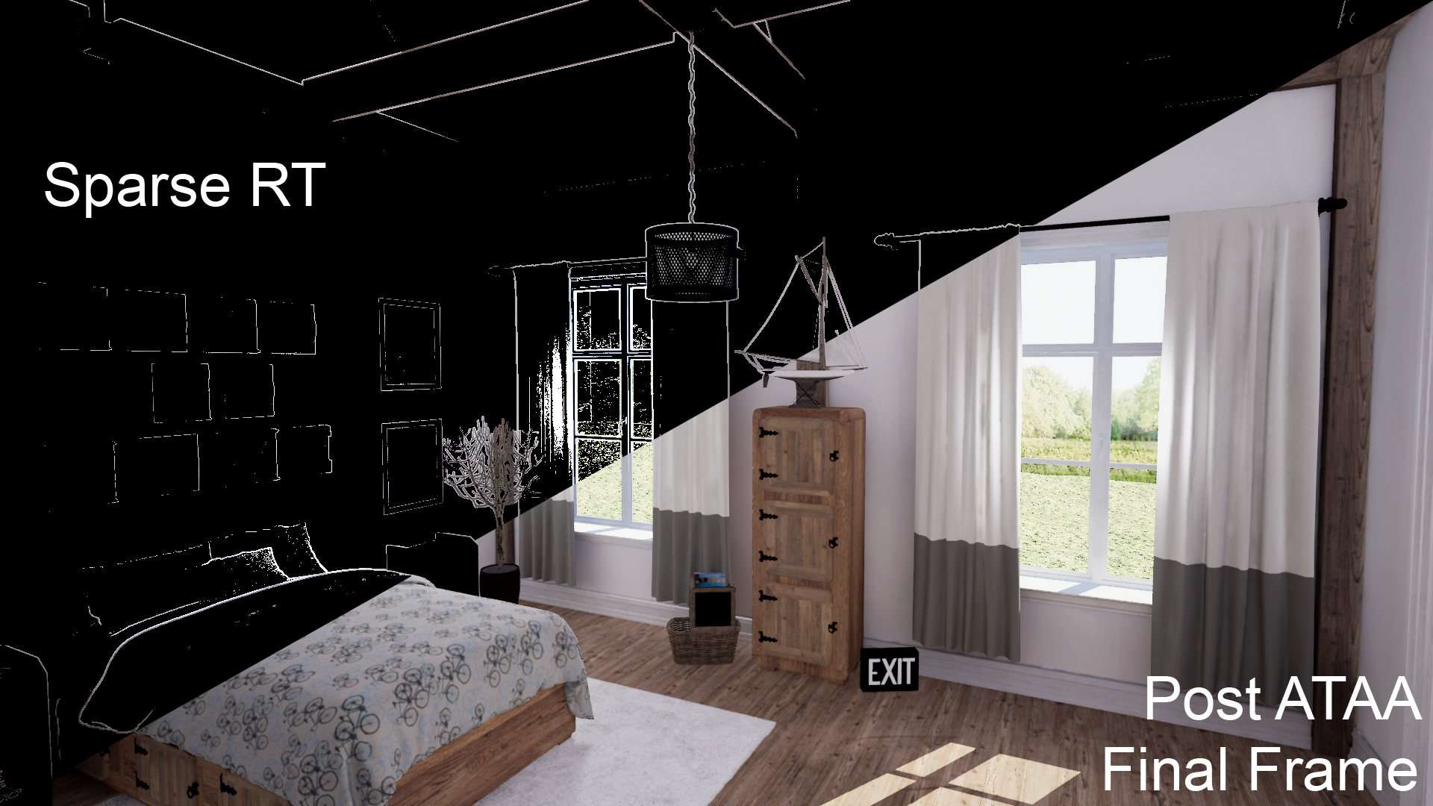
Notes:
The segmentation mask guides the sparse ray tracing step, which is then combined with the normal TAA result to form the final image.

Slide 15
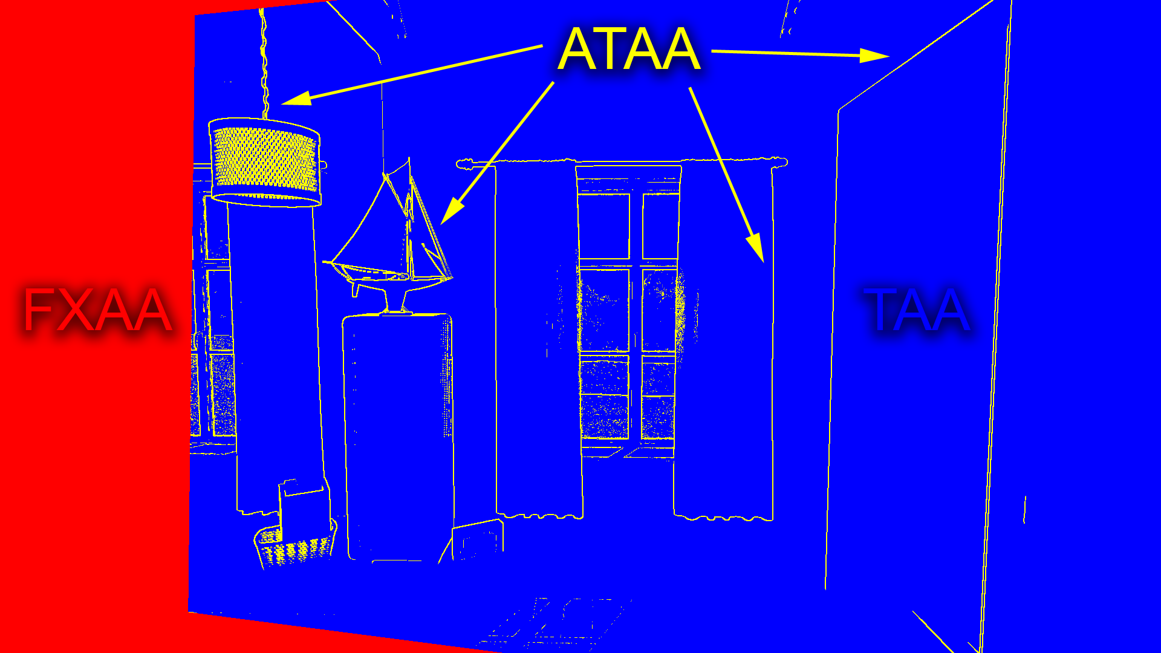
Notes:
The segmentation mask has three regions.
Blue indicates pixels where TAA hasn’t failed, and the final image should use the existing TAA result.
Red pixels visualize where no information exists from a previous frame. These areas persist for a short periods of time, but can sometimes be large, so we apply FXAA here.
Finally, the yellow pixels are marked for ray tracing, since we’ve detected TAA has failed or there is a hard geometric edge that will benefit from more samples.

Slide 16
Adaptive Temporal Antialiasing
Implementation Details
Unreal Engine 4 extended with DXR API support, running on NVIDIA RTX
TAA fullscreen post-process extended to compute and output segmentation mask
Sparse ray tracing in DXR Ray Generation shaders, dispatched as separate fullscreen post-process pass before tonemapping
Each primary ray casts a single shadow ray to the sun’s directional light source (hard shadows)
Notes:
That’s the conceptual overview. We implemented the idea in Unreal Engine 4 extended with DXR API support running on NVIDIA RTX.
The UE4 TAA post-process pass was extended to compute and output the segmentation mask.
Sparse ray tracing is done in DXR ray generation shaders, and dispatched as a separate fullscreen pass before tonemapping.
Each primary ray casts a single shadow ray to the sun’s directional light source to create pixel perfect hard shadows.

Slide 17
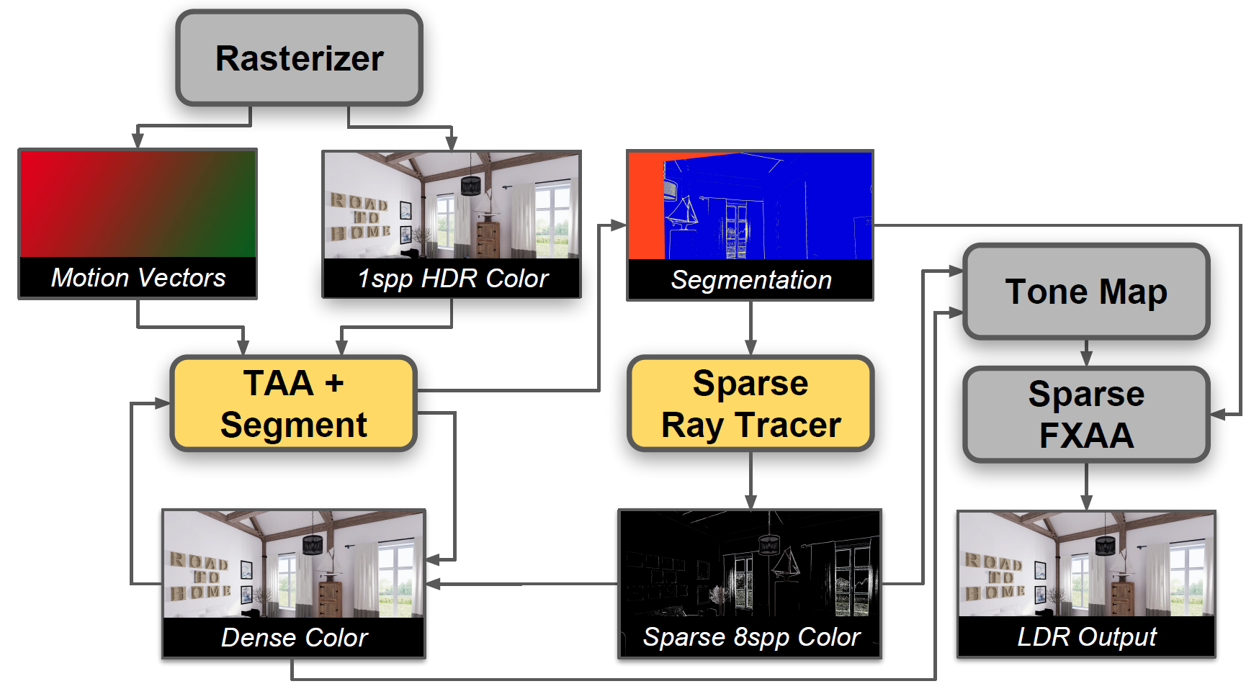
Notes:
Here is a visualization of the data flow of our algorithm as integrated into the UE4 rendering pipeline. Rectangular icons represent visualizations of data buffers, rounded rectangles represent operations on that data implemented as shader passes.
Gray passes are only slightly modified. Yellow passes are new.

Slide 18
Adaptive Temporal Antialiasing
Implementation Details
TAA failure detection (segmentation) is a combination of criteria:
Motion Vectors
Segmentation History, single frame look-back (was this pixel marked as ATAA?)
Luminance, temporal change within a pixel neighborhood
Depth, 3x3 edge-detecting Sobel filter
Frames are almost always dominated by TAA-classified (blue) pixels
Notes:
Our segmentation step, which identified where to ray trace, or use TAA or FXAA, is a combination of criteria:
First we use motion vectors to detect motion as well as if data from the previous frame is available.
Next, we look at the segmentation history using a single frame look back. If the pixel was previously marked for ray tracing, we will continue to ray trace it. This helps temporally stabilize the segmentation mask.
Similar to many TAA implementations, we inspect the temporal change in luminance within a pixel neighborhood.
And finally, we perform a 3x3 edge-detecting Sobel-filter on the depth buffer to determine where hard geometric edges exist.

Slide 19
TAA
Notes:
Now for some results. Here is that same scene in UE4 using stock TAA.

Slide 20
ATAA
Notes:
Here is our ATAA result. If I flip back and forth, you should be able to see the complex mesh of the lamp become much clearer, as well fine details of the plant and boat become evident.

Slide 21
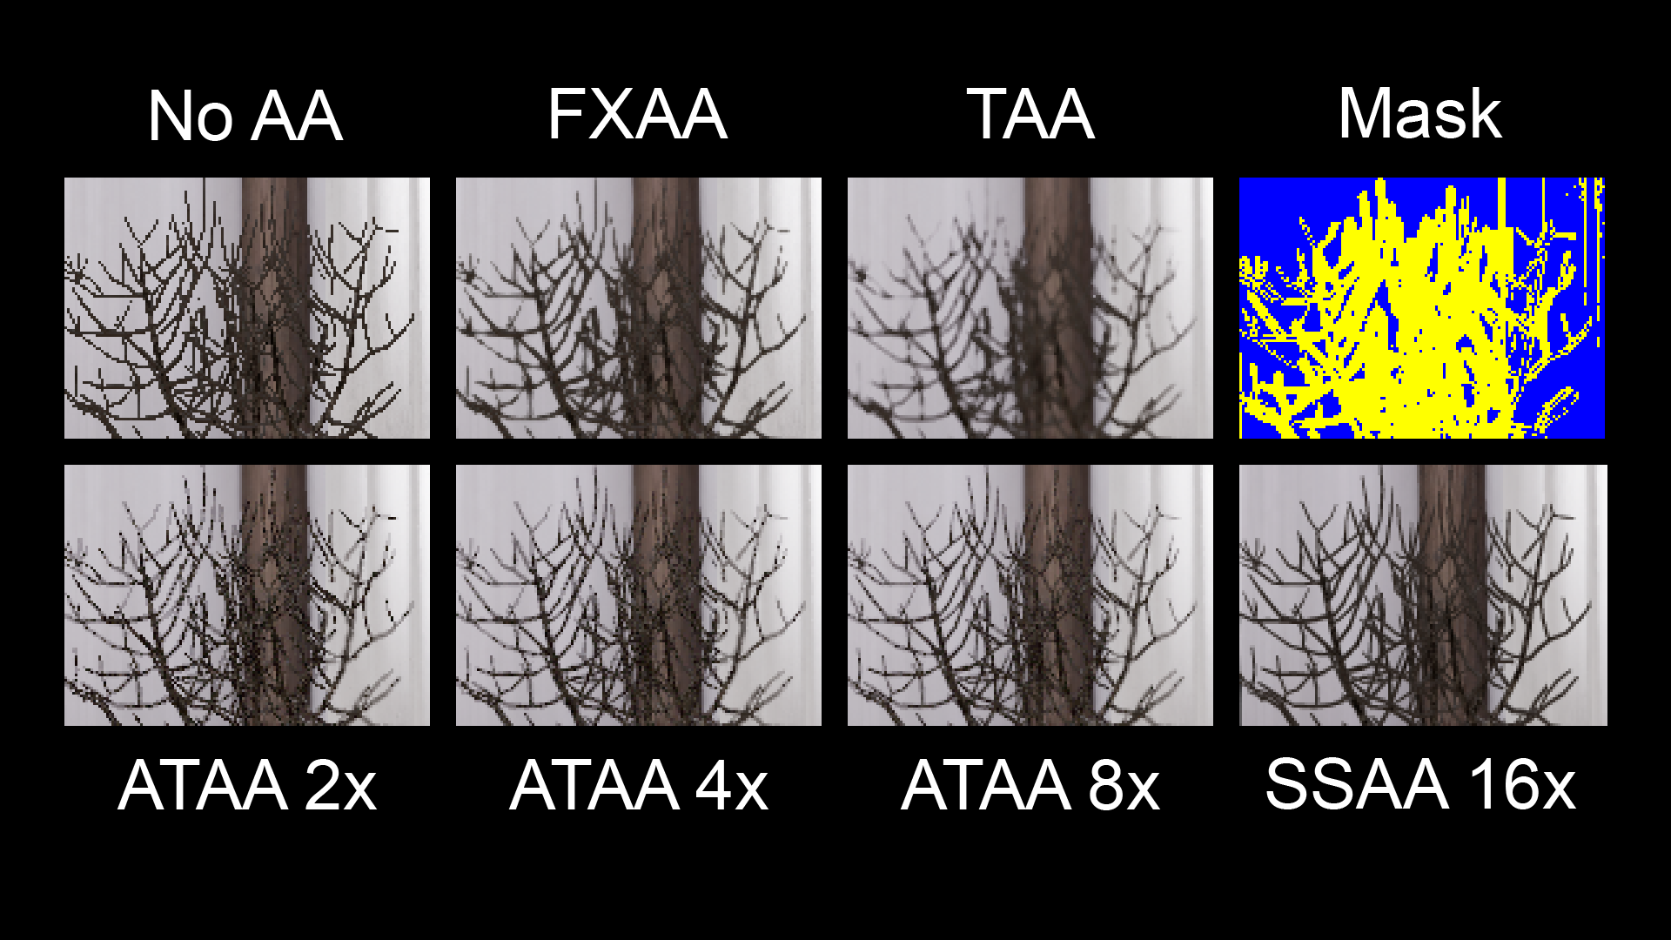
Notes:
I’ve enlarged a few areas here, to make it easier to see the difference between the various AA algorithms.

Slide 22
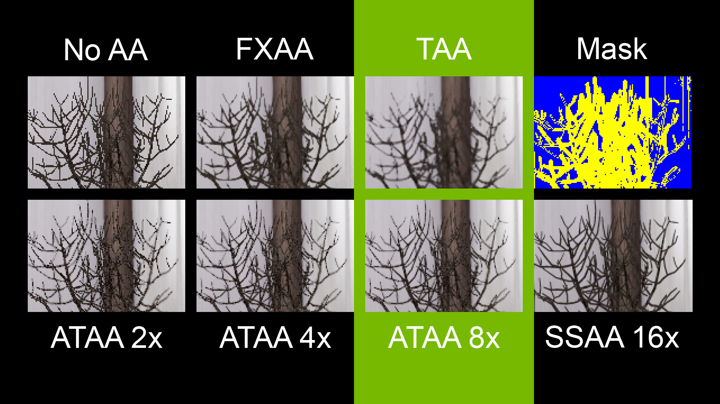
Notes:
Notice how much sharper ATAA is compared to the stock TAA result!

Slide 23
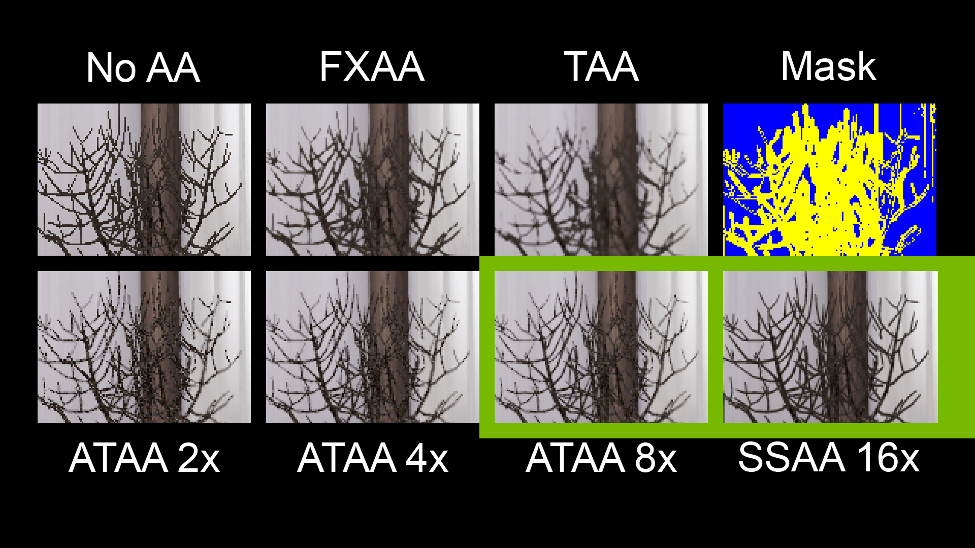
Notes:
In fact, the ATAA 8x result approaches the image quality of 16 times supersampling!

Slide 24
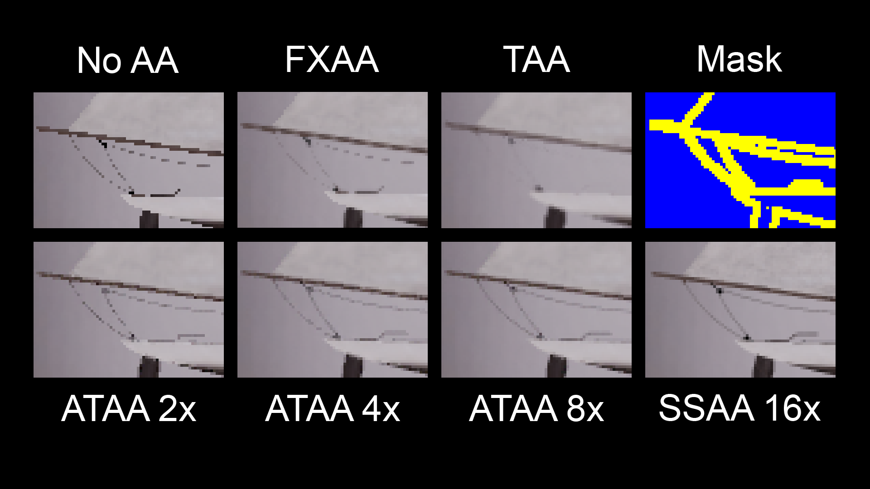
Notes:
Here is another example, this time of the boat.

Slide 25
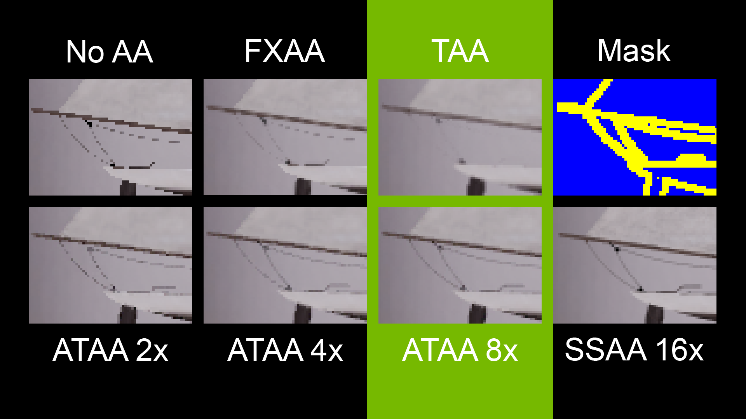
Notes:
Note how FXAA is undersampled, and TAA blurs away the boat ropes.

Slide 26
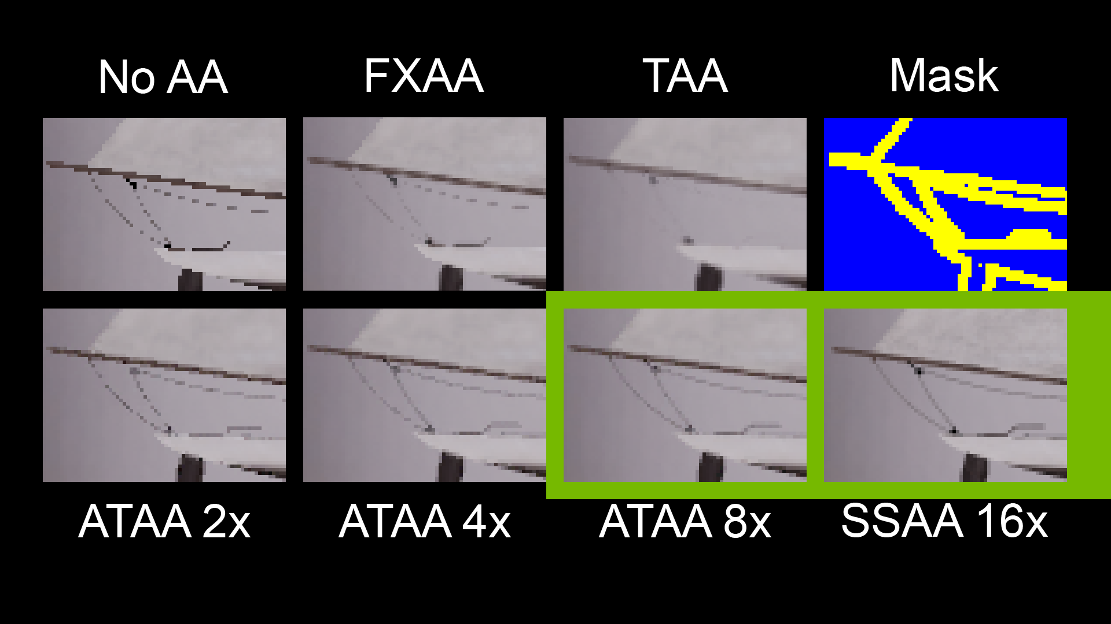
Notes:
The segmentation mask detects these challenging areas, we sample them using ray tracing, and produce a result that is quite close to 16 times supersampling.

Slide 27
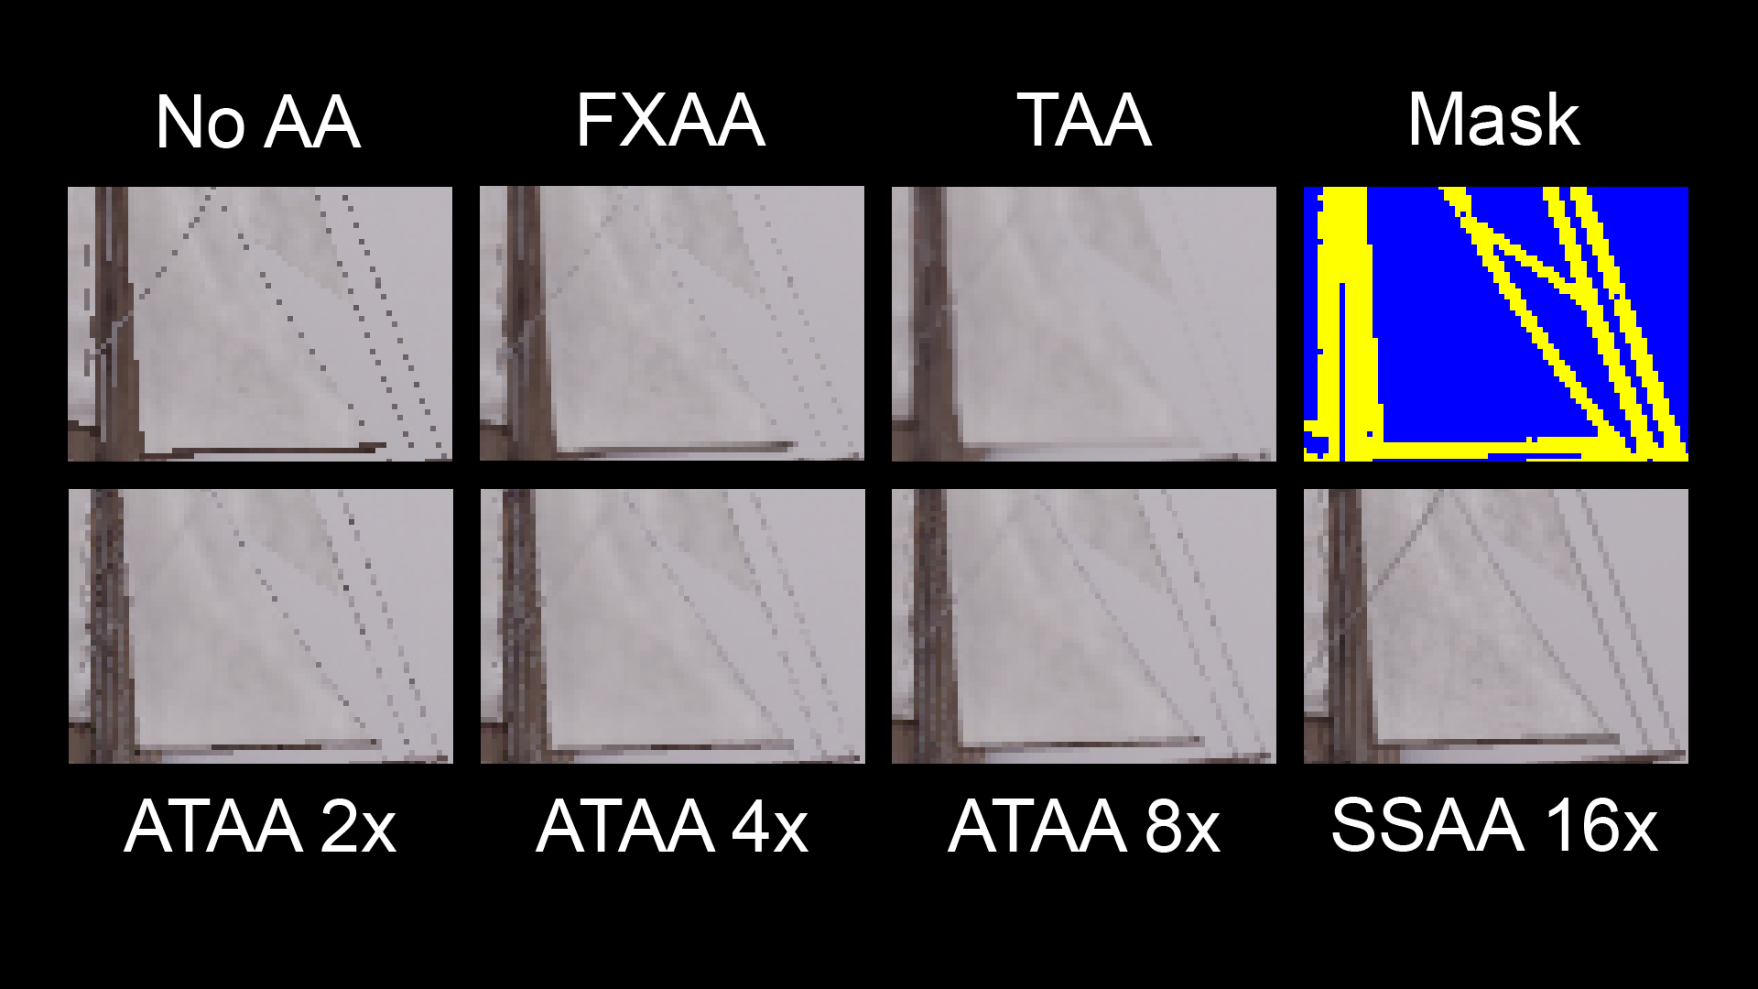
Notes:
Here is another shot of the boat mast and ropes.

Slide 28
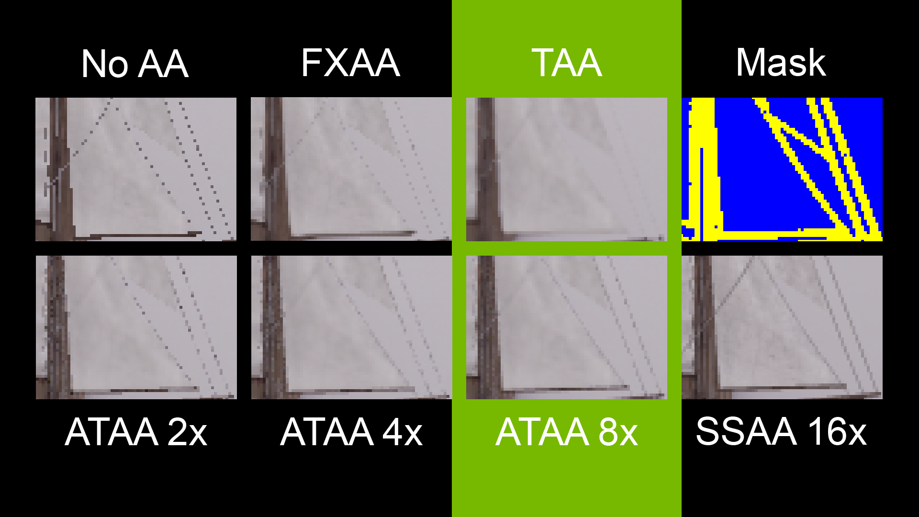
Notes:
TAA blurs away the ropes entirely. Many of the ropes are found by the segmentation step, but some – on the upper left of the image - are missed.

Slide 29
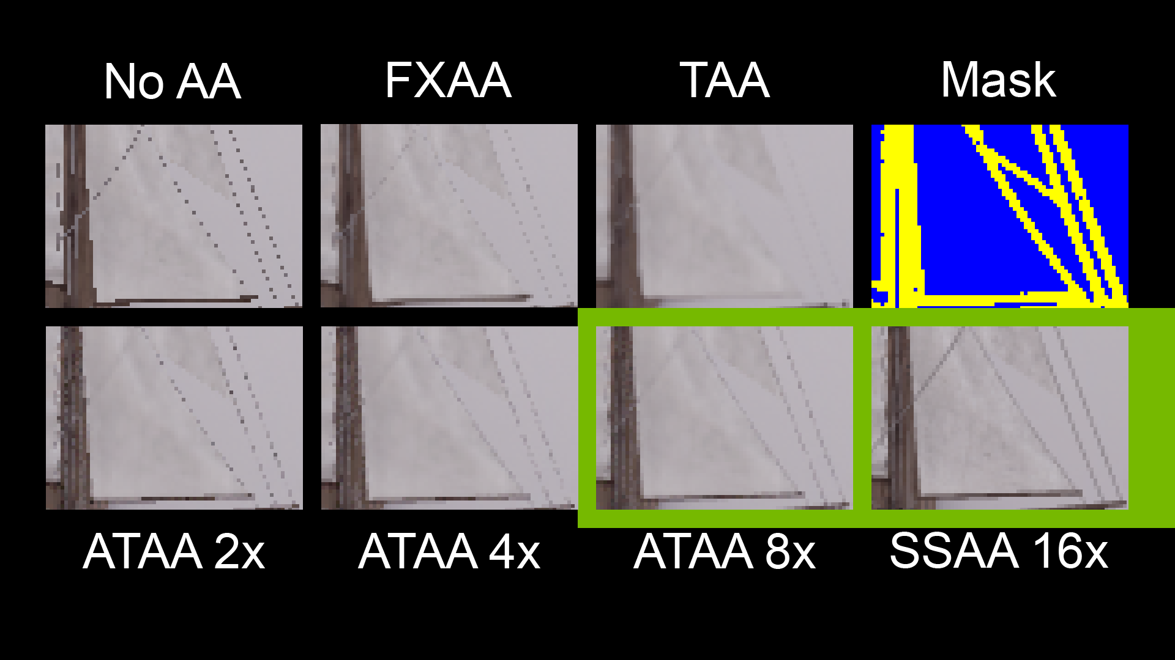
Notes:
In this case, 16 times supersampling looks better than ATAA for this part of the image.

Slide 30
Notes:
Here is another similar failure. The 1spp raster input misses some sub-pixel geometry entirely – making it impossible for our detection approach to make the correct decision.
We have been working on ideas to deal with this problem using conservative rasterization.

Slide 31
Adaptive Temporal Antialiasing
Nota Bene!
Lighting and shading methods between ray and raster must match!
Shadow Rays vs. Shadow Maps, Reflection Cubemaps vs. Reflection Rays
Be aware of pre-AA screen-space algorithms (DoF, Lens Flare, SSAO)
Denoising of area light contributions can make your life tricky
Notes:
A few things to note, that we discovered along the way.
This may seem obvious, but the lighting and shading methods between ray and raster samples must match! Otherwise, you will get some odd results. Although this sounds simple, in a complex environment like UE4 with many options and rendering features, this can be tricky.
We aware that screen space algorithms, like depth of field, lens flare, and SSAO, don’t automatically play nice with your ray traced primary samples.
And finally, if you are doing full screen ray tracing (for shadows or reflections for instance), and applying denoising, that denoising will need to be replicated in the ATAA ray tracing step. This is something that we are interested in looking into further.

Slide 32
Performance
Titan V
1920x1080 resolution, 107,881 pixels selected for RT, 5.2% of total image resolution
Trace, Material Evaluation, Dynamic Lighting, Reflection Probe, 1 Shadow Ray
Variant | Rays | GPU Time (ms) | Optimized GPU Time (ms)
ATAA 8x | 1,693,280 | 18.40 | 16.85
ATAA 4x | 846,640 | 9.30 | 8.55
ATAA 2x | 423,320 | 4.60 | 4.28
Performance figures reported in milliseconds (ms)
Notes:
Finally, I’ve reached the slide about the question that is probably in most of your minds right now. How much does it cost?
We tested the scene you saw earlier on a Titan V at 1080p resolution. The segmentation mask identified ~108 thousand pixels for ray tracing. Each DXR Hit Shader performed material evaluation, dynamic lighting, sampled the reflection probe, and cast 1 shadow ray.
With this workload, I tested three variations of ATAA casting 2, 4, and 8 rays per pixel. We’ve improved performance of the initial numbers reported in the paper, and they are reported here.
Even though performance needs improvement, these are really encouraging initial results since the time to render a frame in UE4 with any ATAA variant is still less than 33ms.
Low ray throughput because of divergence, low occupancy (due to high register count), organization of ray workloads are all limiting factors. Keep in mind we are grouping up rays that are very different ON PURPOSE so this will increase thread divergence on the GPU.

Slide 33
Conclusions
Demonstrated a practical hybrid AA solution in a production game engine for the first time
The adaptive hybrid strategy injects the advantages of best-quality offline AA strategies while avoiding the limitations of existing best performance real-time methods
Real-time even on first-generation ray tracing commodity hardware and software
Just the beginning: of real-time hybrid raster + adaptive ray tracing
Notes:
To wrap up, we’ve discussed a new, practical hybrid AA solution and implemented it within a production game engine for the first time.
We’ve injected the advantages of highly quality offline adaptive AA strategies into existing state of the art real-time AA strategies.
We have a ways to go on performance, but our approach runs in real-tie even on the first generation of commodity GPU hardware and software to support ray tracing.
This is really just the beginning for hybrid raster + adaptive ray tracing solutions.

Slide 34
Adaptive Temporal Antialiasing
Future Work
Performance: dominated by the ray trace. How to handle about denoising approaches?
DXR is still an “experimental” feature of Windows 10!
Mainstream GPUs do not yet exist that support the DXR API
RT ecosystem is still evolving: wide-spread deployment in games not yet recommended
Notes:
Performance is a challenge now, and is dominated by the ray trace.
But, DXR is still and experimental feature of Windows 10, and mainstream GPUs do not yet exist that support the DXR API.
The RT ecosystem is still evolving – and that’s a great thing.

Slide 35
Adaptive Temporal Antialiasing
Future Work
Texture LoD: no forward-difference derivatives in DXR, how to evaluate texture mipmap levels in arbitrary material graphs is an open problem
Improve Sampling & Filtering: casting rays in static 8x, 4x, or 2x MSAA n-rooks patterns
Segmentation: limited by the 1spp raster input. Conservative raster to the rescue?
Improved Adaptivity: enforcing fixed per frame ray budgets and per-pixel ray adaptivity
Notes:
We have a lot of ideas for future work.
First, we have no mechanism for evaluating Texture LoD since forward-difference derivatives are not available in DXR. Solutions for this problem are well known (like ray differentials), for simple materials with known properties.
However, this is an open engineering problem for systems (like UE4) with complex material shaders using many dependent textures of multiple resolutions.
Since this is late breaking work, our sampling patterns are fixed and we use a simple box filter. Experimenting and improving this, along with the segmentation are high on our list. We are also planning on increasing the additivity of rays for each pixel.

Slide 36
Acknowledgements
Coauthors: Josef Spjut, Holger Gruen, Rahul Sathe, and Morgan McGuire
Ignacio llamas, Edward Liu, and the entire NVIDIA ray tracing team
Epic Games

Slide 37
@acmarrs

